Slide 1


EAMS UDQ TRAINING
Reminders on how to avoid the
Unprocessed Document Queue

Slide 2
Welcome to the UDQ Training Module
Some of the reasons we are providing this training opportunity:
DWC’s attempts to remotely address batch failure issues have not been successful.
Continuation of high percentage of batch failures from e-filers.
This is your opportunity to train your staff in filling out eForms so that your batches do not fail to the Unprocessed Document Queue (UDQ).
Improve document submission to avoid account suspension.
Provide a visual reference guide of the most common eForms that err to the UDQ*.
*Please note that the examples provided in the following slides do not identify all of the possible reasons that a batch may end up in the UDQ. Additional links to resources related to workers’ compensation laws and regulations can be found on the DWC website.

Slide 3
Successful E-filing with eForms Topics
Steps for Successful filing
Preparing Case Information and Attachments
Helpful tips from the EAMS E-form Filing Reference Guide (Reference Guide)
Batch ID Management
Proof of Service
Application for Adjudication of Claim eForm
Answer to Application for Adjudication of Claim eForm
Notice and Request for Allowance of Lien eForm
Request for Consultative Rating eForm
Compromise and Release eForm
Stipulations with Request for Award eForm
Unstructured eForm
How to contact the DWC-EAMS Unit for help

Slide 4
Frequently Used Terms and Abbreviations
Department of Industrial Relations = DIR
Division of Workers’ Compensation = DWC
Electronic Adjudication Management System = EAMS
Unprocessed Document Queue = UDQ
Uniform Assigned Name = UAN
EAMS Reference Number = ERN
Adjudication Case (court case) = ADJ
Injured Worker = IW
Date of Birth = DOB
Date of Injury = DOI
Social Security Number = SSN
Workers’ Compensation Judge = WCJ
Third Party Administrator = TPA

Slide 5
Steps For Successful E-filing
What to do before filling out an eForm:
Prepare draft or worksheet.
Gather information for the eForm.
Prepare your attachments.
Review the Reference Guide for form requirements and special instructions. Please note that the Reference Guide is under review, so the information provided in this presentation may differ slightly as it reflects current laws and regulations.
Determine how and when to get assistance from DWC.

Slide 6
Prepare your Drafts or Worksheets
Create a template document for each eForm using a:
  MS Excel Spreadsheet
  MS Word Document
  Blank eForm – print or save a PDF copy
Include all the data fields.
Enter your information into your templates.
Keep a list of common case participants and their addresses if you file often in EAMS.
Remember that the information entered in an eForm must match the information in EAMS for parties existing cases. This may include the injured worker.

Slide 7
Gather Your Data
Internal client intake should include
Injured Worker (IW) information:
Date of Birth (DOB)
Mailing address (Utilize the USPS ZIP code lookup site)
Employer
Date of Injury(ies) (DOI)
Verify all information relating to injured worker name, case numbers and case participants is correct. Social Security Numbers (SSN) are optional and should only be included if authorized to use. Remember to utilize the public search portal to see if the IW has been in the Workers' Compensation system before or may have had their case opened by another party. (Workers' Compensation Public Information Search Tool)

Slide 8
Review Reference Guides
EAMS webpage – Information about filing and working in EAMS with links to guides, document title lists, FAQs, etc.
EAMS E-Filer Reference Guide – Guide to filing eForms. Lists best practices for eForms and their required attachments.
Verify Case Information
Workers' Compensation Public Search Tool – Search Tool for case information for those who are not yet a party to their cases. The Search Tool may be used by any member of the public.
UAN Databases – UAN lookup tool for Claims Administrators, Representatives, and Lien Claimants UANs and ERNs.

Slide 9
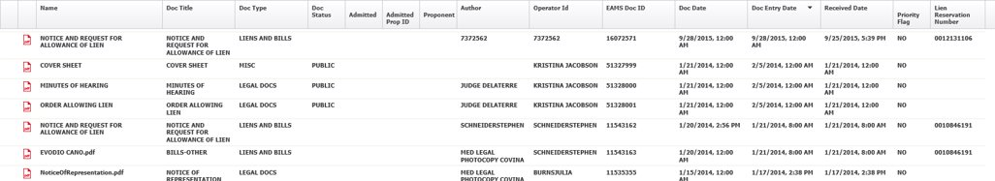
Preparing Attachments
Please review the Document Title List located on the E-form filers webpage to determine the correct document title to use when attaching your documents to the eForm.
  Required attachments for eForm being filed.
  Correct method of descriptively labeling attachments to eForms.
  Do not attach OCR coversheets or separator sheets to the scanned attachment(s).

Slide 10
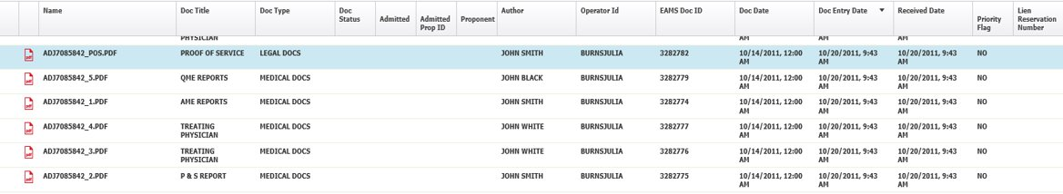
Preparing Attachments cont.
Below is an example of incorrect labeling of attachments to eForms:
Notice documents that are not descriptively named. (ADJ1234567.PDF)
Attachment should be renamed prior to uploading.
Author: If created by a UAN holder the UAN should be used. If created by the physician, the Doctor's name should be used.
Document Date – should not be the date the documents are submitted, but the date the actual document was created and/or signed.

Slide 11
Helpful tips from the Reference Guide
Reference Guide
Do not use punctuation or special characters in names and addresses. (see pages 9, 16, 36 & 81)
Use USPS abbreviations for addresses. (see page 80)
Enter the same name and address for forms that are submitted after case opening, so that duplicate case participants are not created.
Who is the Author? (see page 9)
Document size limits – 25 pages per §10205.12(a)(10).
Black ink only – black/white copies only per §10205.12(a)(2).
S Signature format. (see page 41)

Slide 12
Helpful tips from Reference Guide cont.
Reference Guide
Check all UANs against the UAN database. (see pages 7-9)
Review the Document Title Spreadsheet: Not all titles will generate workflow for a case, so choose carefully.
Check for an existing case number using the Workers’ Compensation Public Search Tool or EAMS.
Documents filed into an incorrect case will not err to the UDQ. (see page 68)
Do not use “aka” (also known as) when listing an IW or Employer names.

Slide 13
Batch ID Management
Confirmation of Filing (see pages 14-15 in the Reference Guide)
Always save a copy of the Batch ID page, in text format, in the specific case folder in your system and print a hard copy as additional backup. This is verification of the submission date and time should there be a question about when a document was filed into the case in EAMS. Once you close the Batch ID window it cannot be recovered.
The Batch ID page that pops up after you submit your eForm will not list the eForm or documents in the packet. This information should be noted and maintained by your e-filing staff.
The UDQ operator will advise you of errors with your filing by referencing the Batch ID number. To easily track Batch ID numbers in your case, we recommend that you use a tracking system such as an Excel spreadsheet. See the example below for suggested column headings.

Slide 14
eForms: Batch Run Schedule
Batch runs will initially process workflow, e.g., events and tasks. Images will show up in FileNet after these processes are complete. Please note this may take one or more business days to complete, so if it is not filed within a week, please contact the EAMS Help Desk (EAMSHELPDESK@dir.ca.gov) for assistance.
Current EAMS Batch Run Schedule:
Monday through Friday*:
AM: 6:30, 7:30, 8:30, 9:30, 10:30, 11:30
PM: 12:30, 2:30, 3:30, 4:30, 5:30, 6:30, 9:00
*Except holidays.

Slide 15
Selected eForms for Review
Proof of Service
Application for Adjudication of Claim (App)
Answer to Application for Adjudication of Claim (Answer to Application)
Notice and Request for Allowance of Lien
Request for Consultative Rating
Compromise and Release (C&R)
Stipulations with Request for Award (STIP)
Unstructured

Slide 16
Proof of Service
Reference Guide (see page 36)
Every e-filed batch is required to include a Proof of Service.
Your Proof of Service must include the following information in the upper left-hand corner.
Uniform Assigned Name
EAMS Primary Administrator Name
EAMS Primary Administrator’s Phone – Direct or with Extension
EAMS Primary Administrator’s Email
Include the injured worker’s (IW) name and EAMS case number.
If you are submitting a document via the Unstructured eForm, please list the document title(s) you have attached in case there are issues later.

Slide 17
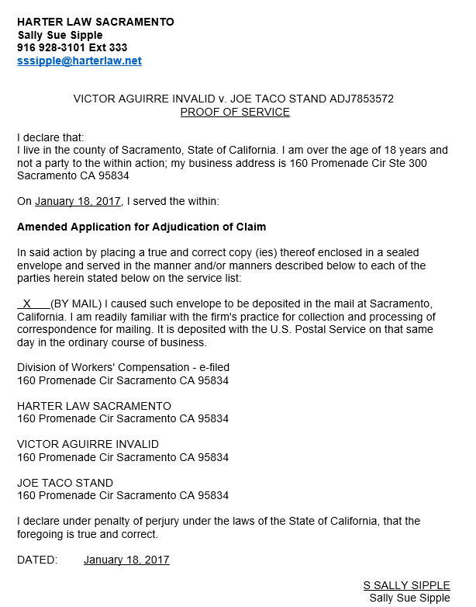
Proof of Service-Good Example
Has the required information needed in the upper left-hand corner.
The IW’s name and case number has been included.
The type of eForm submitted is listed.
Lists all parties from the case being served.

Slide 18
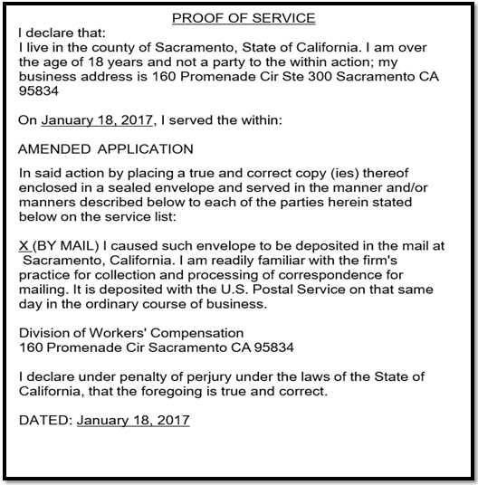
Proof of Service-Bad Example
Does not include the required information needed in the upper left-hand corner.
The IW’s name and case number has not been included.
Does not list all parties from the case being served.

Slide 19
Application for Adjudication Requirements
Reference Guide (see pages 50-53)
eForm: Application for Adjudication of Claim
Required attachments for case opening Application when filed by an IW’s Representative.
LC §4906(h) Declaration
Fee Disclosure Statement
Venue Verification
Proof of Service
Required attachments when filed by a Lien Claimant for case opening Application
LC §4906(h) Declaration
Verification for Lien or Application by Lien Claimant. (previously 10770.5)
Proof of Service

Slide 20
Application for Adjudication Common Errors
IW name and/or Date of Birth (DOB) does not match intake documents signed by the IW or match what is in EAMS, if the IW had a prior workers’ compensation case.
Venue zip code does not match IW address, injury address, or Applicant Attorney’s address depending on venue choice.
Date of Injury (DOI) entered in the DOB field.
Law Firm or Claims Administrator UANs are incorrect or in the wrong field.
Parties on Application eForm do not match those on the Proof of Service. The parties listed in the Proof of Service must be listed in the eForm. Remember it is the eForm that populates the parties and information in EAMS.
4906(h) Declaration not submitted for the Law Firm, only for the injured worker or vice versa.
Attachments are illegible or not the current version.
Incorrect S Signature format.

Slide 21
Application for Adjudication Helpful Tips
Verify the UAN(s) you are adding into the eForm in the searchable UAN database. They should also have the correct role for the field you are filling in. A law firm UAN cannot be entered in a lien claimant or a claims administrator field unless those roles are enabled on their UAN by the Central Registration Unit (CRU).
Verify IW information from Workers' Compensation Court Public Search Tool or your intake documents. Please note that incorrect IW information is the most common error for documents in the UDQ.
Verify that all S signature(s) are in correct format (ex. S JOHN SMITH). No dashes, middle initials, titles, etc.
Check that the Parties on Application eForm match those on the Proof of Service. The parties listed in the Proof of Service must be listed in the eForm. Remember it is the eForm that populates the parties and information in EAMS.

Slide 22
Application for Adjudication Helpful Tips cont.
Review attachments for legibility, correctness, meeting the requirements for filing and that they have an appropriate descriptive document name.
Review contents of the eForm then print it out or save it to your computer before clicking ‘Submit’. If you receive an error message, please remember to print out or save the eForm again to your computer after corrections have been made, because you must serve a complete copy to the other parties listed in your paperwork.

Slide 23
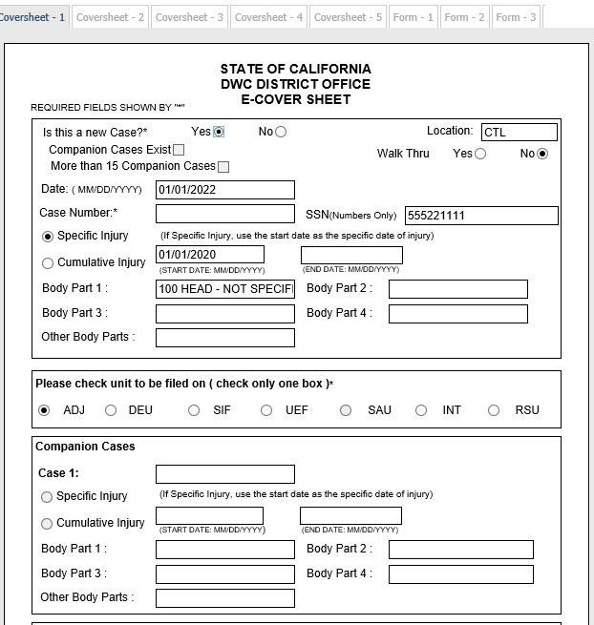
Application for Adjudication of Claim Coversheet
New case: Yes or No. Yes = case opening, No = amended.
Location: Choose CTL. (indicates the form is e-filed)
Walk Thru: NO (see §10789 for permitted walk-through documents).
Companion cases exist: DO NOT CHECK.
More than 15 Companion cases: DO NOT CHECK.
Date: Enter today’s date MM/DD/YYYY.
Case Number: If case opening App leave blank, if Amended App enter the ADJ case number assigned to the DOI.
Social Security Number: Optional. (no dashes, just numbers)

Slide 24
Application for Adjudication of Claim Coversheet Cont.
Injury type: For a case opening App check the correct radio button. For an Amended Application, these fields will be blocked until the Amended Application checkbox on Form 1 is checked.
Specific Injury MM/DD/YYYY
Cumulative Injury MM/DD/YYYY - MM/DD/YYYY
Body Part 1-4: Select from the dropdown menu if case opening App. If this is an amended App these fields will be blocked.
If there are more than four body parts add "700 Multiple Body Parts" to the "Other Body Parts" field.
You may add an addendum to your packet listing all body parts in a letter format. Please use "CORRESPONDENCE – OTHER" as the document title.
Choose Unit type: Select ADJ.
Companion Cases: Not allowed on an Application.

Slide 25
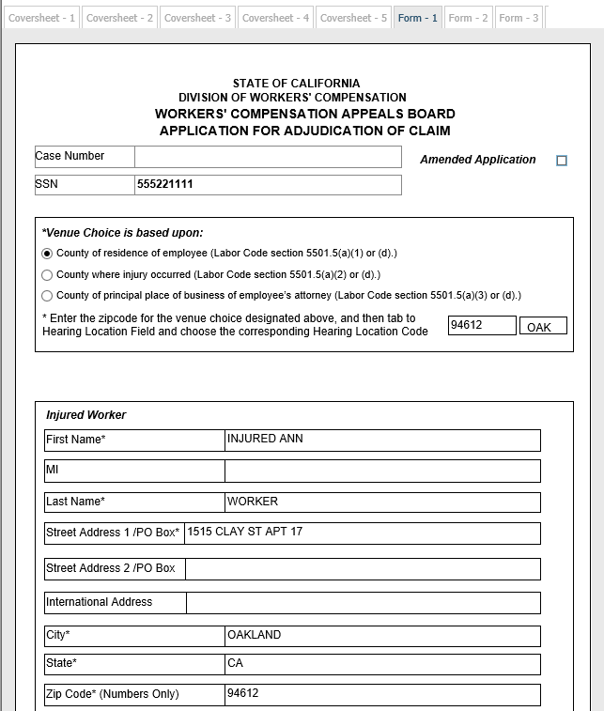
Application for Adjudication of Claim Form 1
Case Number: Field will be blank for case opening App but will auto-populate for the amended App.
Amended Application box: Check if you are amending the App. If a DOI has already been assigned an ADJ this will fail to the UDQ, unless this box is checked.
SSN: Auto-populates from the coversheet.
Venue choice: Select the appropriate venue button and enter the zip code based on the radio button selection.
  County of employee (IW) residence zip code must match the employee zip code.
  County where injury occurred zip code.
  County of principal place of employee's (IW’s) attorney may only be used if the Application is filed by the employee’s attorney.

Slide 26
Application for Adjudication of Claim Form 1 Cont.
Injured Worker Section:
First Name: First name only.
Middle Initial: One letter only.
Last Name: If adding second last name do not use hyphens.
Injured Worker Address:
Street Address 1: Please use USPS format.
Street Address 2: Please use USPS format.
International Address: If your Injured Worker (IW) has moved out of the country please use this box for additional address information.
City: Verify your city and zip code match.
State: Choose the correct two letter abbreviation from the dropdown menu.
Zip Code: Five digits only.

Slide 27
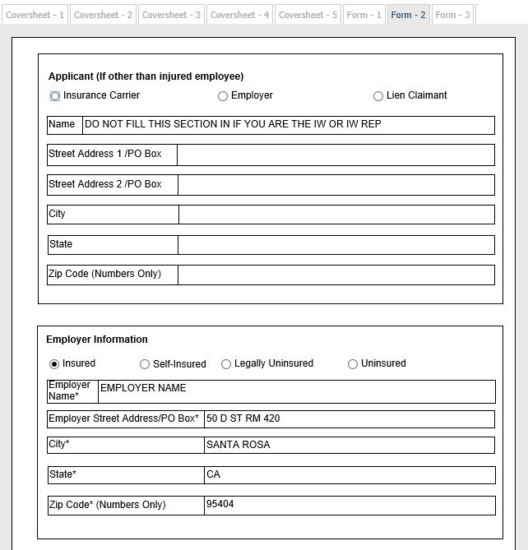
Application for Adjudication of Claim Form 2
Applicant field (If other than injured employee):
Applicant radio buttons:
If the App is submitted by the Insurance Carrier, Employer or Lien Claimant please choose the appropriate button.
These buttons cannot be unselected once chosen.
Name: Lien Claimants should use their UAN, while Insurance Carriers may use the Claims Administrator UAN.
Applicant Address:
Street Address: Please use USPS format.
City: Verify your city and zip code match.
State: Choose the correct two letter abbreviation from the dropdown menu.
Zip Code: Five digits only.

Slide 28
Application for Adjudication of Claim Form 2 Cont.
Employer Information field:
Type of employer radio buttons: You must select one type of insured/uninsured status for the employer.
Employer Name: The business/legal name of the employer.
Employer Address:
Street Address: Please use USPS format.
City: Verify your city and zip code match.
State: Choose the correct two letter abbreviation from the dropdown menu.
Zip Code: Five digits only.

Slide 29
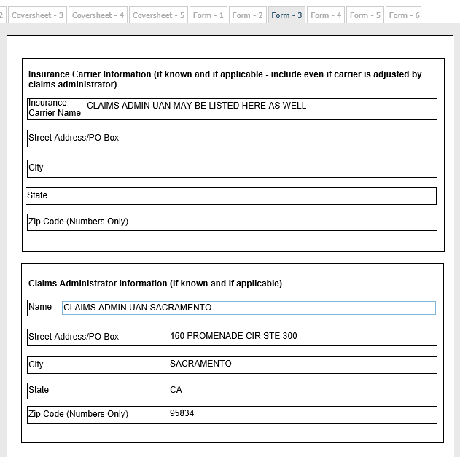
Application for Adjudication of Claim Form 3
Insurance Carrier field:
Insurance Carrier Name: The Claims Administrator UAN may also be used for this field.
Insurance Carrier Address:
Street Address: Please use USPS format.
City: Verify your city and zip code match.
State: Choose the correct two letter abbreviation from the dropdown menu.
Zip Code: Five digits only.

Slide 30
Application for Adjudication of Claim Form 3 Cont.
Claims Administrator field:
Claims Administrator Name: Enter the Claims Administrator UAN. Some larger insurance companies have more than one Claims Administrator office location so please verify that you have the correct UAN location.
Claims Administrator Address:
Street Address: Please use USPS format.
City: Verify your city and zip code match.
State: Choose the correct two letter abbreviation from the dropdown menu.
Zip Code: Five digits only.

Slide 31
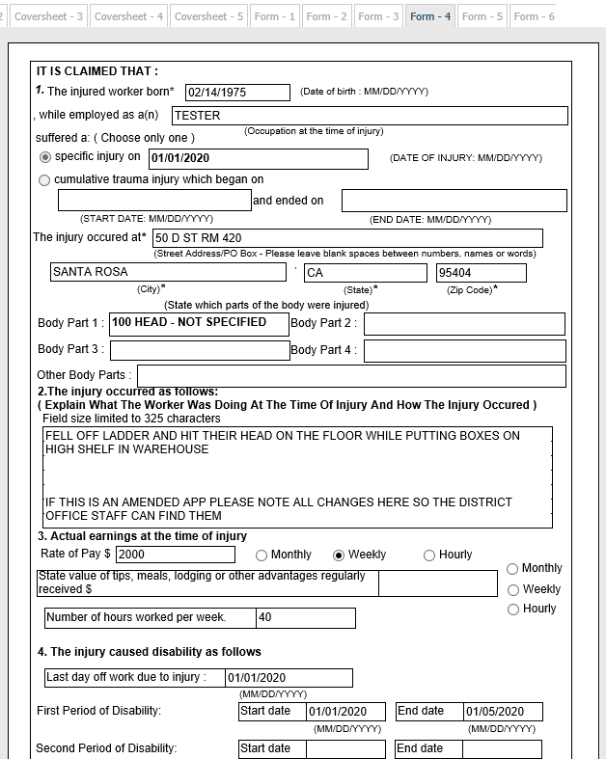
Application for Adjudication of Claim Form 4
Section 1:
Injured Worker Date of Birth (DOB): Enter DOB and verify that it is not the DOI as this can create a duplicate IW profile, duplicate case, or err to the UDQ.
While employed as: Enter job title.
Specific or Cumulative DOI: DOI will populate from the coversheet if this is a case opening App.
The injury occurred at: Enter address where the injury occurred.
Body Parts: Body parts will populate from the coversheet if case opening App.
Section 2:
The injury occurred as follows: If case opening, describe the incident. If Amended App, list all corrections needed so they are not missed.

Slide 32
Application for Adjudication of Claim Form 4 Cont.
Section 3
Actual Earnings at time of injury:
Rate of Pay.
Monthly, Weekly or Hourly, please choose one.
State value of tips...
Fill in amount in the box to the right.
Monthly, Weekly or Hourly, please choose one.
Number of hours worked per week:
Fill in amount in the box to the right.
Section 4
The injury caused disability as follows, all fields require dates using MM/DD/YYYY format.
Last day off work due to injury MM/DD/YYYY.
First period of disability MM/DD/YYYY.
Second period of disability MM/DD/YYYY.

Slide 33
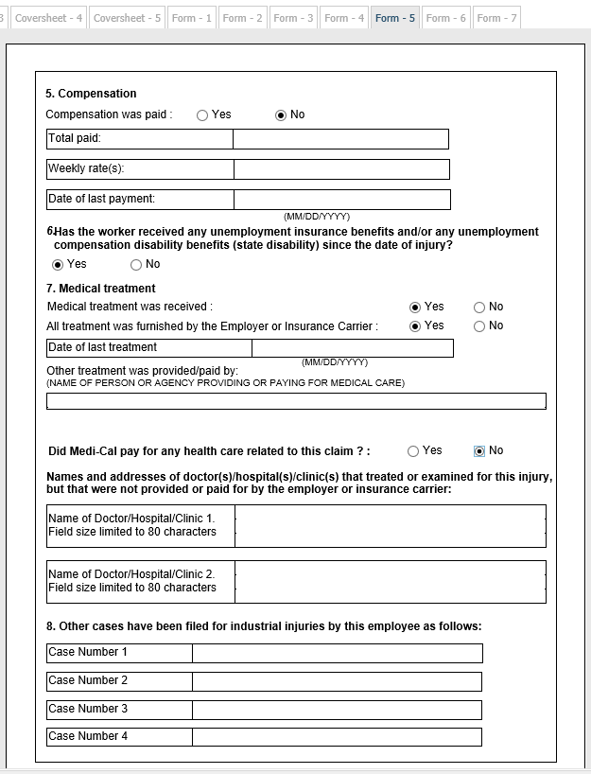
Application for Adjudication of Claim Form 5
Section 5
Compensation was paid? Yes or No.
Total Paid (numbers and decimal point only)
Weekly rate(s) (numbers and decimal point only)
Date of last payment MM/DD/YYYY.
Section 6
Has the IW received unemployment insurance or disability benefits? Yes or No.
Section 7
Medical Treatment
Medical treatment received? Yes or No.
All treatment furnished...? Yes or No.
Date of last treatment MM/DD/YYYY.
Other treatment was provided by: Please list payee of medical care.

Slide 34
Application for Adjudication of Claim Form 5 Cont.
Section 7 cont.
Did Medi-Cal pay healthcare related to claim? Yes or No.
List all doctors/medical facilities that provided care not paid for by the employer/insurance company. If there is not enough room a detailed response can be attached as an addendum using the document title CORRESPONDENCE – OTHER.
Section 8
Other cases have been filed for industrial injuries: List any other previous cases or companion cases here.

Slide 35
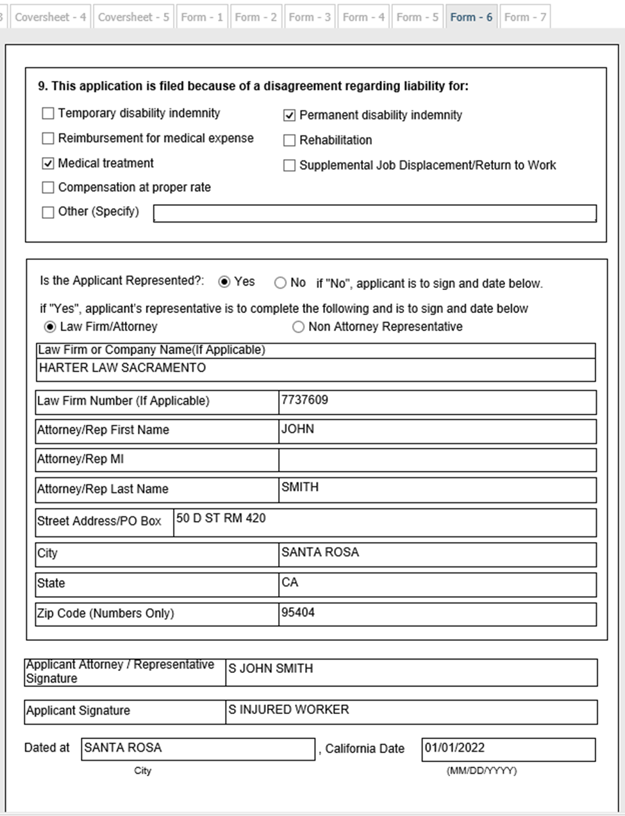
Application for Adjudication of Claim Form 6
Section 9
This application is filed because: Check all boxes that apply.
Applicant Representation:
Is the Applicant Represented? Yes or No.
Applicant Law Firm/Attorney Non Attorney Representative:
If "Yes" please check the button that applies.
Law Firm/Company Name: UAN of Law Firm/Non Attorney Representative.
Law Firm Number: ERN of Law Firm/Non Attorney Representative.
First Name: First name only.
Middle Initial: One letter only.
Last Name: If adding second last name do not use hyphens.

Slide 36
Application for Adjudication of Claim Form 6 cont.
Applicant Law Firm/Representative cont.:
Law Firm Address: Street Address, City, State, Zip Code should match the UAN address.
Street Address: Please use USPS format.
City: Verify your city and zip code match.
State: Choose the correct two letter abbreviation from the dropdown menu.
Zip Code: Five digits only.
Signatures:
Applicant Attorney/Representative signature:
S Signature (S JOHN SMITH): If applicant is represented.
Applicant signature: S Signature of IW or other applicant: If unrepresented.
Dated at: Add City and California Date (MM/DD/YYYY) of App submission.

Slide 37
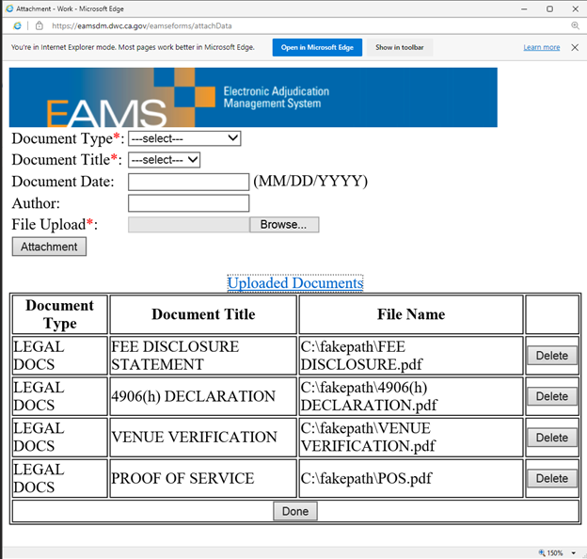
Application for Adjudication of Claim
Attachments & Submissions
Add all mandatory and optional attachments.
Take a screenshot or print a copy of the attachment page.
Review the data in the eForm for accuracy.
Print the eForm for service on all parties.
Click submit.
Take a screenshot, save as a text file, and/or print the Batch ID page.
Update your Batch ID spreadsheet.

Slide 38
Answer to Application Requirements
Reference Guide (see page 53)
eForm: Answer to Application
Required attachments:
    4906(h) Declaration (Attorney or Claims Administrator)
Proof of Service

Slide 39
Answer to Application Common Errors
Incorrect IW information.
  Name transposed.
Employer registered twice when information provided did not match what is in EAMS.
Incorrect Claims Administrator UAN.
Incorrect Declarant information.
  S Signature.
  UAN missing.
Listing companion cases.
Proof of Service is incorrect or missing.
Non-numerical characters entered in the Phone Number field will cause an error that causes the batch to fail to the UDQ, which cannot be corrected.

Slide 40
Answer to Application Helpful Tips
Verify IW information by reviewing intake documents or Workers’ Compensation Public Search Tool.
Verify Employer information using the Workers’ Compensation Public Search Tool.
Verify UANs entered in the Claims Administrator and/or Insurance Carrier fields using the UAN database.
Utilize the correct S Signature format: S JOHN SMITH.
Remember to include your Proof of Service.
Review attachments for correctness and meeting the requirements.
Review contents of form, then ‘Print' before clicking ‘Submit,’ as you must serve other parties to the case.

Slide 41
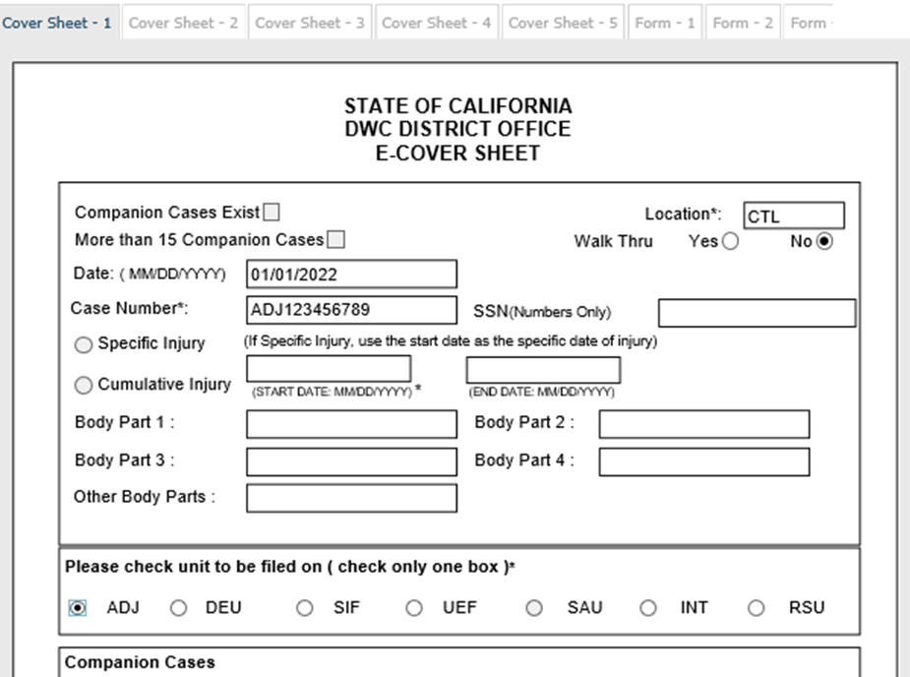
Answer to Application Coversheet
Location: Choose CTL (indicates the form is e-filed)
Walk Thru: NO. (see §10789 for permitted walk-through documents)
Companion cases exist: DO NOT CHECK. (each answer to application must be filed individually)
More than 15 Companion cases: DO NOT CHECK.
Date: Enter today’s date MM/DD/YYYY.
Case Number: Enter the ADJ case number.
Social Security Number: Blocked.
Injury type and date: Blocked.
Body part: Blocked.
Unit radio button: ADJ.

Slide 42
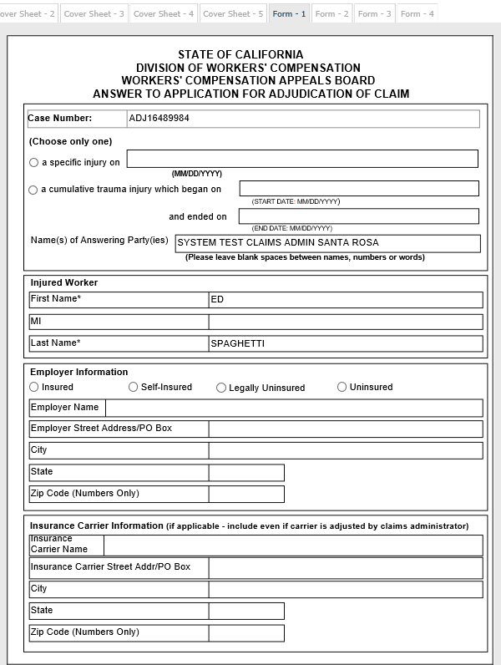
Answer to Application Form 1
Case number: Auto-populates from coversheet.
DOI (Date of Injury): Optional.
Name(s) of Answering Party(ies): Enter the UAN, unless uninsured.
Injured worker Information field:
First name: Mirror what is in EAMS.
Last name: Mirror what is in EAMS.
Employer Information field:
Type of employer radio buttons: You must select one type of insured/uninsured status for the employer.
Employer Name: Enter the business/legal name, which should mirror what is in EAMS. (EAMS will create a second employer if there are any variations)

Slide 43
Answer to Application Form 1 cont.
Employer Information field cont.:
Employer Address:
Street Address: Please use USPS format.
City: Verify your city and zip code match.
State: Choose the correct two letter abbreviation from the dropdown menu.
Zip Code: Five digits only.
Insurance Carrier field:
Insurance Carrier Name: The Claims Administrator UAN may also be used for this field.
Insurance Carrier Address:
Street Address: Please use USPS format.
City: Verify your city and zip code match.
State: Choose the correct two letter abbreviation from the dropdown menu.
Zip Code: Five digits only.

Slide 44
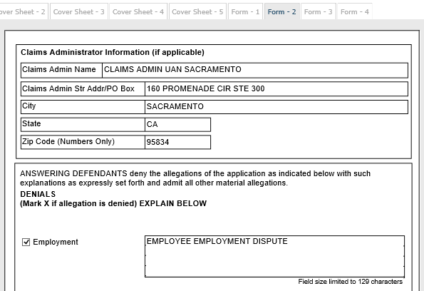
Answer to Application Form 2
Claims Administrator field:
Claims Administrator Name: Enter the Claims Administrator UAN. Some larger insurance companies have more than one Claims Administrator office location so please verify that you have the correct UAN location.
Claims Administrator Address:
Street Address: Please use USPS format.
City: Verify your city and zip code match.
State: Choose the correct two letter abbreviation from the dropdown menu.
Zip Code: Five digits only.

Slide 45
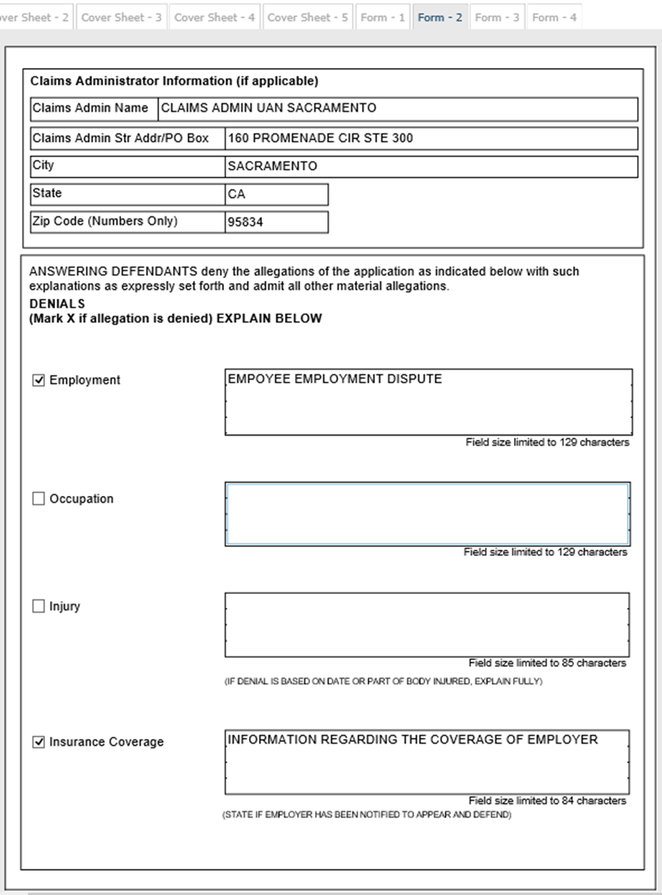
Answer to Application Form 2 cont.
Answering Defendants: Please check any/all boxes that are being denied by the defendant(s). (Provide at least one of the 12 denials, along with an explanation)
Examples:
Employment
Occupation
Injury
Insurance coverage
Field Size Limited: If you need to provide more information than the field allows, please summarize in the eForm and attach an addendum to the eForm using the CORRESPONDENCE – OTHER document title. Include a note about the addendum in the summary field.

Slide 46
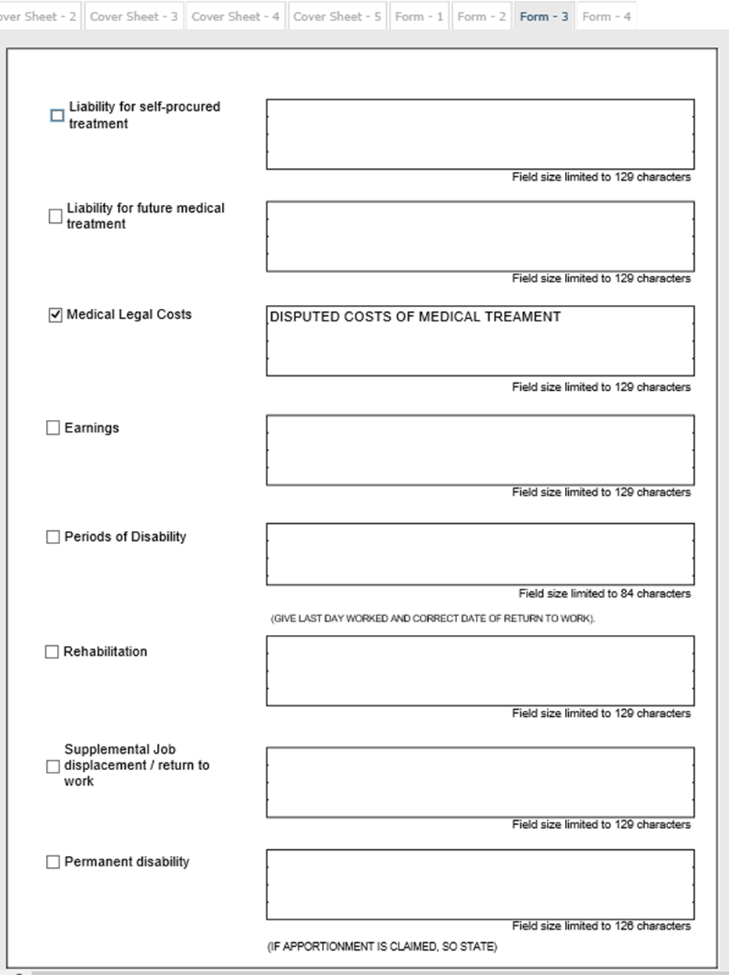
Answer to Application Form 3
Examples continued:
Liability for Self-procured treatment
Liability for future medical treatment
Medical Legal Costs
Earnings
Periods of Disability
Rehabilitation
Supplemental Jon displacement / return to work
Permanent disability
Field Size Limited: If you need to provide more information than the field allows, please summarize in the eForm and attach an addendum to the eForm using the CORRESPONDENCE – OTHER document title. Include a note about the addendum in the summary field.

Slide 47
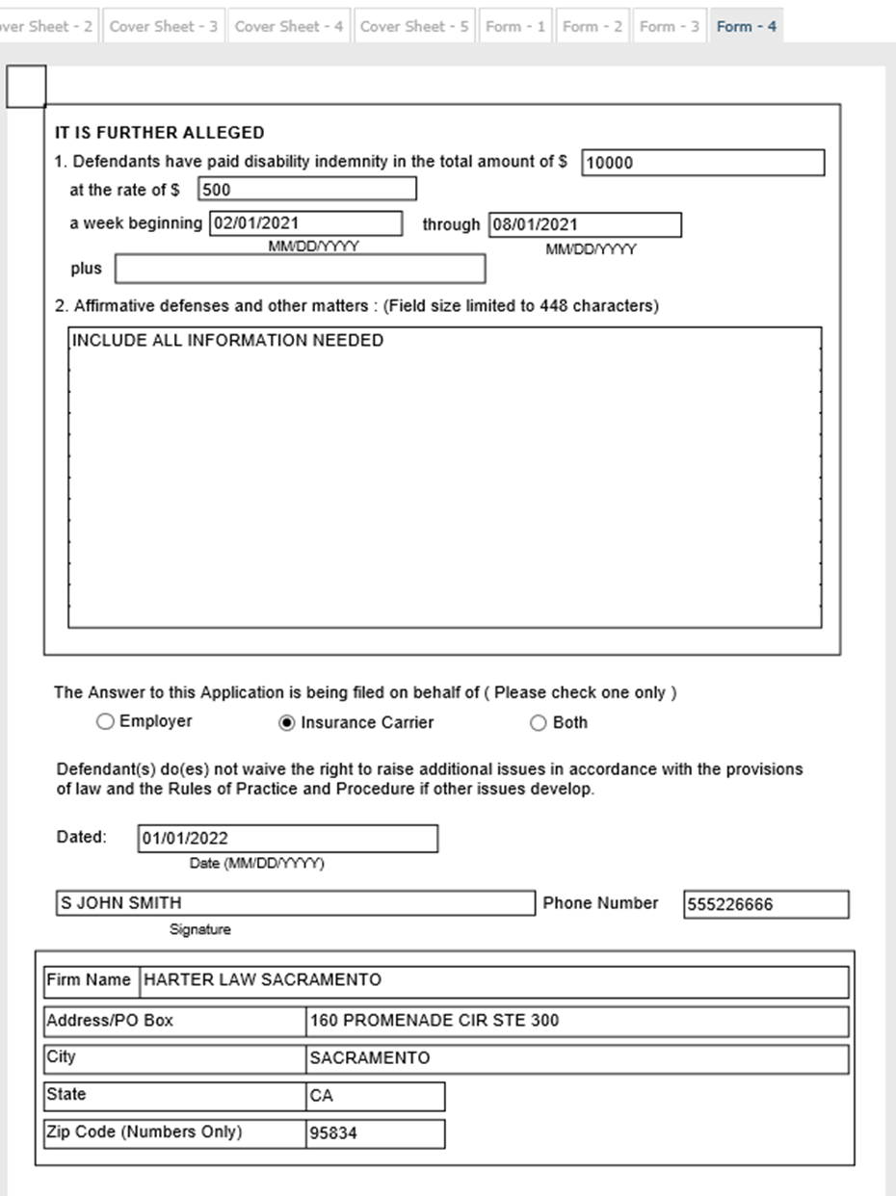
Answer to Application Form 4
It is further alleged:
1. Defendants
total amount (only numbers and a decimal point)
at the rate of (only numbers and a decimal point)
a week beginning: MM/DD/YYYY
through: MM/DD/YYYY
plus: MM/DD/YYYY
2. Affirmative defenses and other matters: Text box.
The Answer to this Application:
Radio Buttons: Select Employer, Insurance Carrier, or Both.
Dated: MM/DD/YYYY
S Signature.
Phone Number. (numbers only)

Slide 48
Answer to Application Form 4 cont.
Law Firm Name: UAN of Law Firm/Non Attorney Representative.
Law Firm Address:
Street Address: Please use USPS format.
City: Verify your city and zip code match.
State: Choose the correct two letter abbreviation from the dropdown menu.
Zip Code: Five digits only.

Slide 49
Notice and Request for Allowance of Lien Requirements
Reference Guide (see pages 58-61)
eForm: Notice and Request for Allowance of Lien
Required Attachments:
Verification for Lien or Application by Lien Claimant § 10863. (previously § 10770.5)
If needed, attach the 10390 statement to the Verification.
Declaration or Assignment requirements:
  LC 4903.8(d) (declaration of lien claimant)
or
  LC 4903.8(a)(b) (assignment of lien)
LC 4903.05 requirements:
  Original Bill
  Itemized Statement
Proof of Service

Slide 50
Notice and Request for Allowance of Lien Common Errors
Incorrect case number, IW information, information in Provider Declaration section for ‘B’ liens with payment, and S Signatures.
UAN for Lien Claimant and Lien Claimant Representative fields are often swapped.
Defective or missing Proof of Service.
Missing required attachments:
  Verification for Lien or Application by Lien Claimant
  LC 4903.8 (d) or LC 4903.8 (a)(b)
  Proof of Service
  Original Bill

Slide 51
Notice and Request for Allowance of Lien Helpful Tips
Do not enter incorrect information in non-mandatory fields. (DOI, SSN, DOB)
IW address fields must be completed. If you do not have the street address, you may use "PROTECTED PER DWC POLICY." (page 60 of the Reference Guide)
Use UANs for Law Firms, Claims Administrators and Lien Claimants in appropriate fields.
Lien amount must be entered as numbers and a decimal point may be used. Do not use any other punctuation or text.
Do not enter duplicate rendering/billing provider entries.
Use Lien Claimant S Signature only for the Declaration.
FAQs for lien declaration.
Review attachments for correctness and meeting the requirements.
Review contents of form, then ‘Print’ before clicking ‘Submit’.

Slide 52
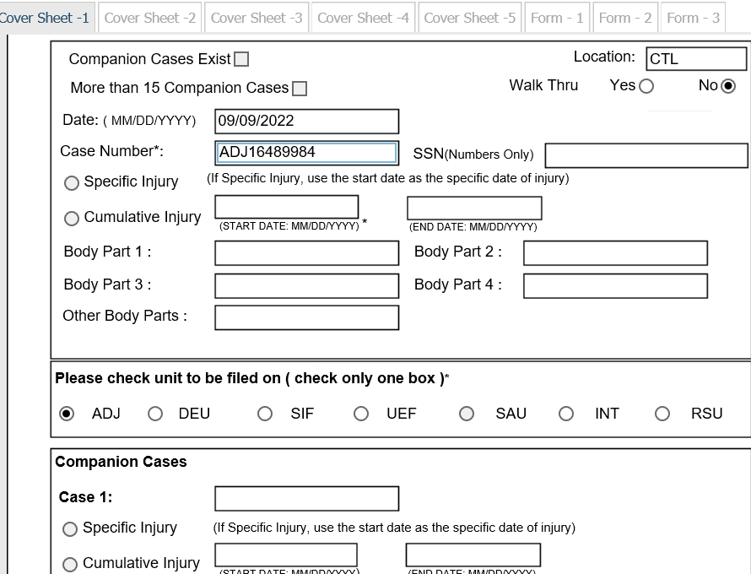
Notice and Request for Allowance of Lien coversheet
Location: Choose CTL. (indicates the form is e-filed)
Walk Thru: NO.
Companion cases exist: DO NOT CHECK.
More than 15 Companion cases: DO NOT CHECK.
Date: Enter today’s date MM/DD/YYYY.
Case Number: Enter the ADJ case number.
Social Security Number: Blocked.
Injury type/date: Blocked.
Body Parts: Blocked.
Choose Unit type: Select ADJ.
Companion Cases: Must be filed separately.

Slide 53
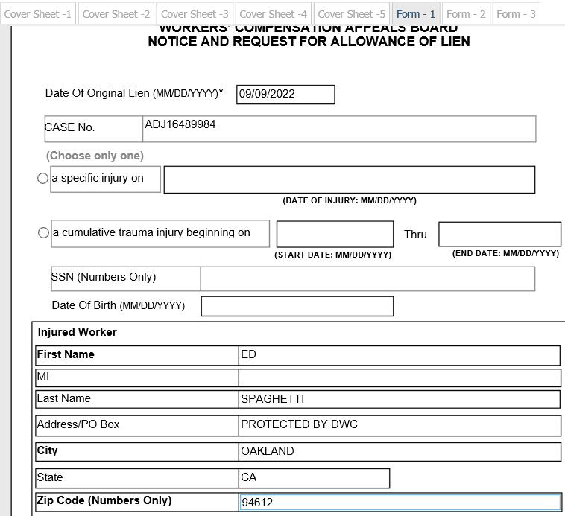
Notice and Request for Allowance of Lien Form 1
Date of Original Lien: Enter today’s date MM/DD/YYYY.
Case Number: Auto-populates from the coversheet.
Injury Type: Optional.
Social Security Number: Optional. (number only, no dashes)
Date of Birth: MM/DD/YYYY.
Injured Worker Section:
First Name: Mirror what is in EAMS, otherwise it will fail.
Middle Initial:
Last Name: Mirror what is in EAMS, otherwise it will fail.

Slide 54
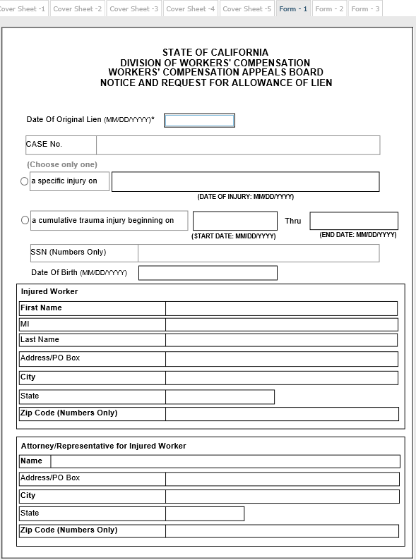
Notice and Request for Allowance of Lien Form 1 Cont.
Attorney/Representative for Injured Worker:
Law Firm Name: UAN of Law Firm/Non Attorney Representative.
Law Firm Address:
Street Address: Please use USPS format.
City: Verify your city and zip code match.
State: Choose the correct two letter abbreviation from the dropdown menu.
Zip Code: Five digits only.

Slide 55
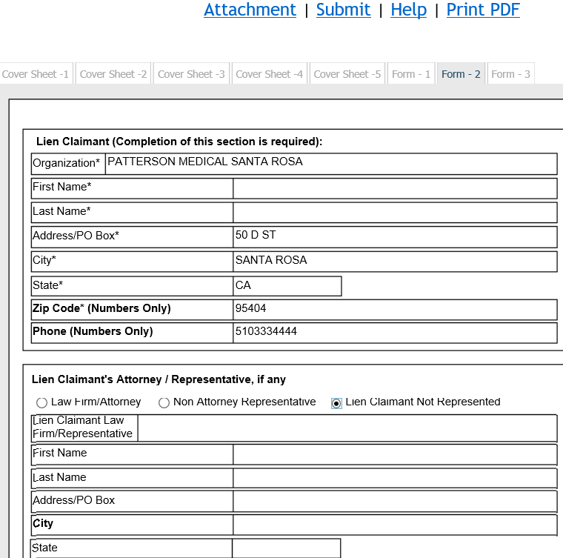
Notice and Request for Allowance of Lien Form 2
Lien Claimant Section:
Organization: Enter Lien Claimant UAN in this section.
First Name: LEAVE BLANK. (only organization field should be used)
Last Name: LEAVE BLANK. (only organization field should be used)
Lien Claimant Address:
Street Address: Please use USPS format.
City: Verify your city and zip code match.
State: Choose the correct two letter abbreviation from the dropdown menu.
Zip Code: Five digits.

Slide 56
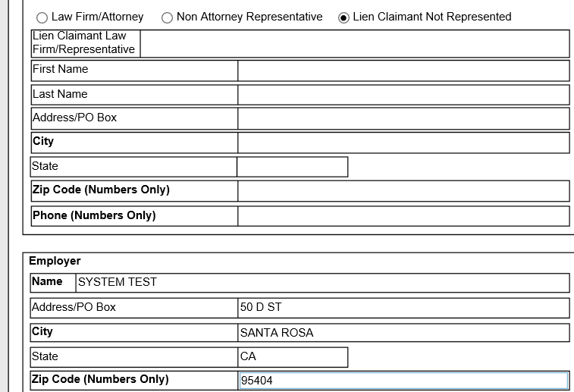
Notice and Request for Allowance of Lien Form 2 cont.
Lien Claimant Attorney/Representative (if any):
Click the correct radio button:
Law Firm/Attorney
Non Attorney Representative
Lien Claimant Not Represented
Law Firm Name: UAN of Law Firm or Non-Attorney representative. (do not list in house representatives or duplicate Lien Claimant information)
Law Firm Address
Street Address: Please use USPS format.
City: Verify your city and zip code match.
State: Choose the correct two letter abbreviation from the dropdown menu.
Zip Code: Five digits only.

Slide 57
Notice and Request for Allowance of Lien Form 2-Employer
Employer Section:
Employer Name: Do not use a UAN here, just the Business/Legal Name of the employer.
Employer Address:
Street Address: Please use USPS format.
City: Verify your city and zip code match.
State: Choose the correct two letter abbreviation from the dropdown menu.
Zip Code: Five digits only.

Slide 58
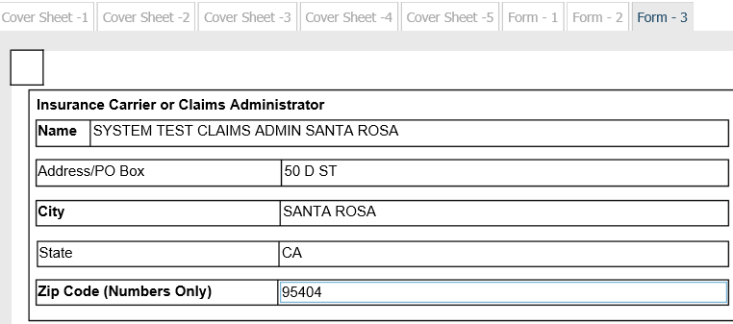
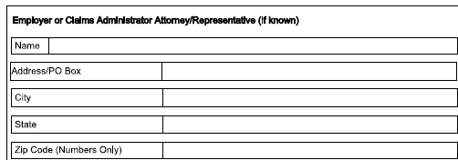
Notice and Request for Allowance of Lien Form 3
Insurance Carrier or Claims Administrator field:
Claims Administrator Name: Enter Claims Administrator UAN in this section.
Claims Administrator Address:
Street Address: Please use USPS format.
City: Verify your city and zip code match.
State: Choose the correct two letter abbreviation from the dropdown menu.
Zip Code: Five digits only.
Employer or Claims Administrator Attorney/Representative:
Law Firm Name: UAN of Law Firm/Non Attorney Representative.
Law Firm Address
Street Address: Please use USPS format.
City: Verify your city and zip code match.
State: Choose the correct two letter abbreviation from the dropdown menu.
Zip Code: Five digits only.

Slide 59
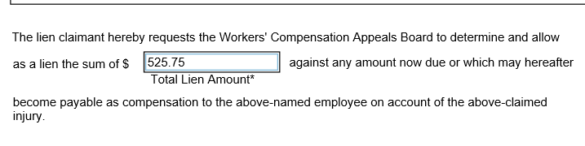
Notice and Request for Allowance of Lien Form 3 cont.
The Lien Claimant hereby requests...:
Total Lien Amount: Numbers and a decimal point only.
Do not enter other special characters such as dollar signs, commas or dashes.
Do not enter text such as Approx, TBD or a range of amounts.

Slide 60
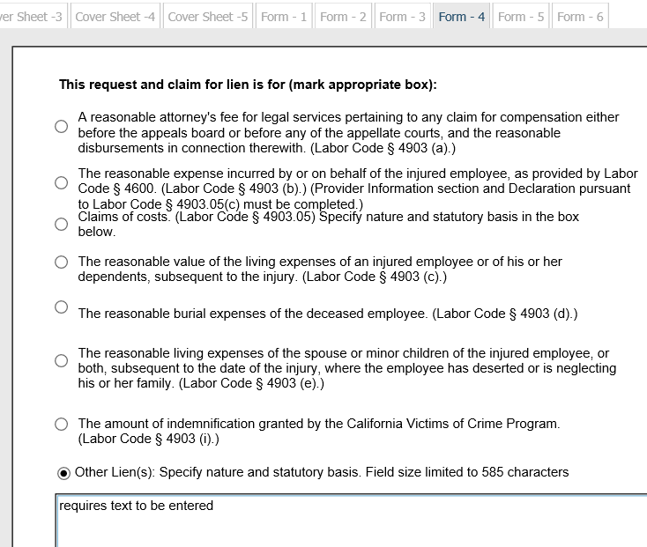
Notice and Request for Allowance of Lien Form 4
This request and claim for lien is for (mark appropriate box): States the reason for lien
Select correct radio button. (only one)
'Other Lien(s)' reason requires information in the text box. (585 character limit)

Slide 61
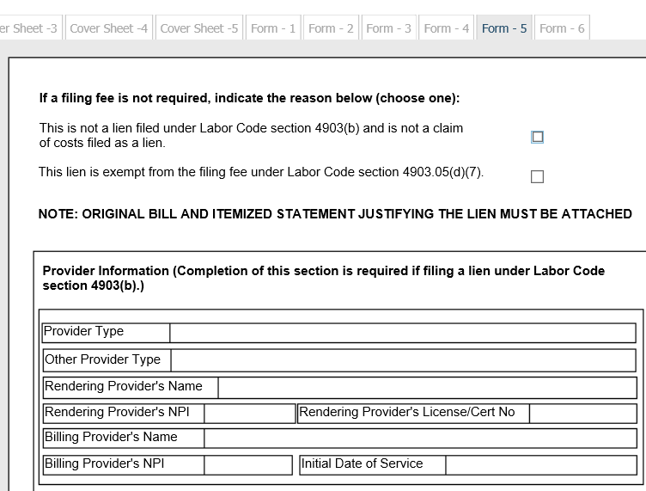
Notice and Request for Allowance of Lien Form 5
  If a Filing Fee is not required, indicate the reason below: Choose one checkbox only.
  Please refer to Labor Code 4903(b) and Labor Code 4903.05(d)(7) for the most appropriate box.
  Provider Information Section (required for 4903(b) liens) this section is mandatory for liens that require a filing fee.
  Provider Type
  Other Provider Type
  Rendering Provider’s Name
  Rendering Provider’s NPI
  Rendering Provider’s License/Cert No
  Billing Provider’s Name
  Billing Provider’s NPI
  Initial Date of Service

Slide 62
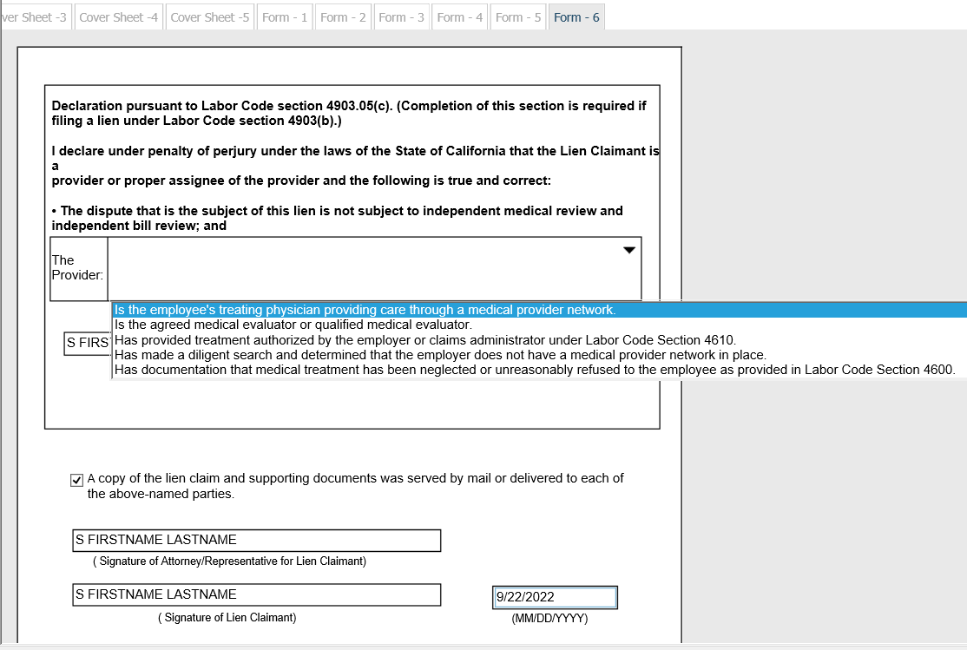
Notice and Request for Allowance of Lien Form 6
Declaration pursuant to Labor Code 4903.05(c)...: For liens that require a filing fee.
  Dispute for filing of lien: Select one Declarant statement only.
  Signature of Lien Claimant: Enter S Signature of Provider.
  Date: Auto-populated by system.
Check the service box.
S Signatures:
S Signature for Lien Claimant's Attorney or Representative.
S Signature for Lien Claimant.
Date: Enter date format MM/DD/YYYY.

Slide 63
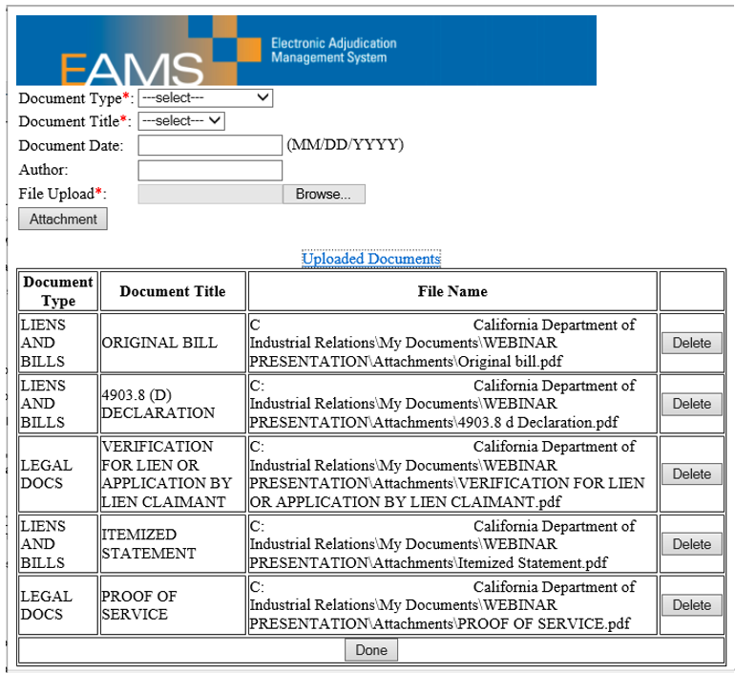
Notice and Request for Allowance of Lien
Attachments & Submissions
Add all mandatory and optional attachments.
Take a screenshot or print the attachment page.
Review the data in the form for accuracy.
Print the eForm for service on all parties.
Click submit:
You will then be taken to a payment screen if filing fee required.
Once your fee is paid you must click “Continue" to be taken to your Batch ID page.
Take a screenshot or print the Batch ID information.
Update your Batch ID spreadsheet.
Overview of payment processing screens to follow.

Slide 64
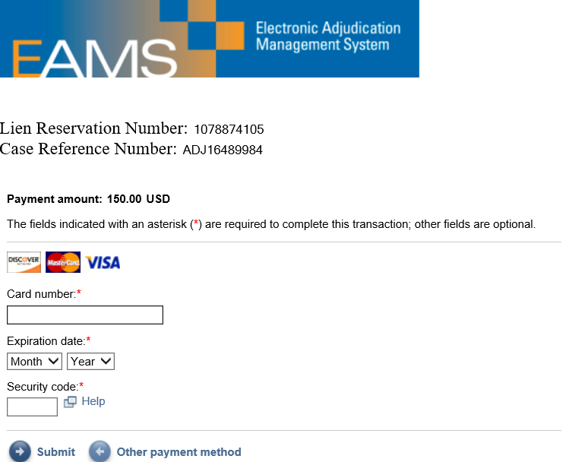
Notice and Request for Allowance of Lien
Payment Process
For liens that require a payment, clicking ‘Submit’ routes the e-filer to the IBM payment center.
Select payment type:
ACH (takes up to 2 weeks to process)
Credit card: Only Discover, MasterCard or Visa.
Enter payment information and click ‘Submit’.
Email is optional: A confirmation email will be sent with payment confirmation information if an email address is provided.
Payment confirmation information page displayed. (print a copy for your record)
Click ‘Continue’ to submit the lien with payment and obtain your Batch ID information.

Slide 65
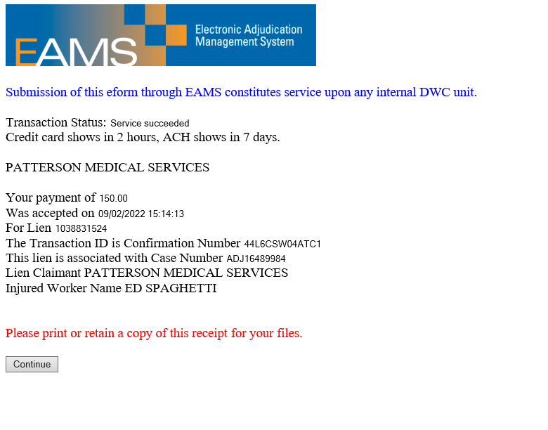
Notice and Request for Allowance of Lien
Payment Process cont.
Print or save this page as a text document for the Confirmation Number and Reservation Number.
Click ‘Continue’ to go back to EAMS for Batch ID.

Slide 66
Notice and Request for Allowance of Lien Payment Process Sample – Response Email
From: payments@dir.ca.gov
Sent: Friday, December 23, 2016 4:12 PM
To: Smith, John
Subject: Your payment has been successfully received for Case Reference Number: ADJ7085842, Lien Reservation Number: 0011294992
Date: 12/23/2016
INCLUSIVE MEDICAL SERVICES SACRAMENTO :
Your payment of: $150
Was accepted on: 12/23/2016 16:08:18
For Lien: 0011294992
Confirmation Number: QMYHSDW08PTC1
Case Number: ADJ7085842
Lien Claimant: PATTERSON MEDICAL SACRAMENTO
Injured Worker Name: VICTOR AGUIRRE INVALID
Date of Injury: 10/01/2006 00:00:00
PLEASE PRINT OR RETAIN A COPY OF THIS RECEIPT FOR YOUR FILES.
Please allow a minimum of two (2) hours for your payment to be reflected in the public search tool.
Payments made after 10:00 PM will not be posted until 6:00 AM the next day.

Slide 67
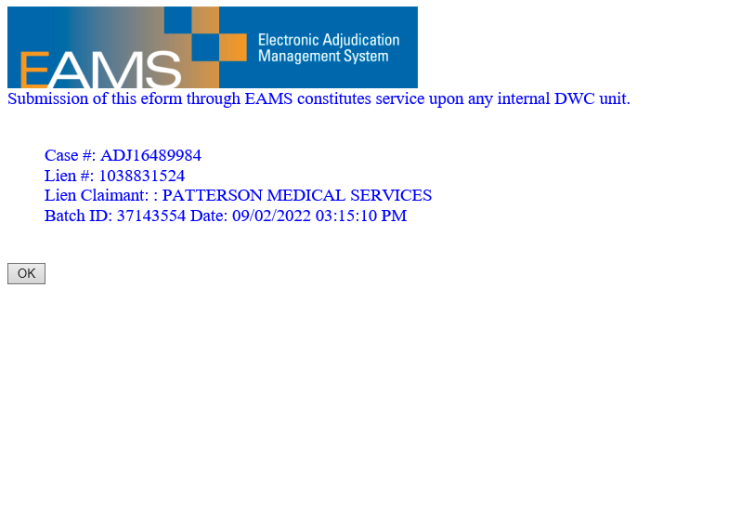
Notice and Request for Allowance of Lien
Payment Process Sample – Batch ID
Lien Batch ID includes:
Case Number
Lien Reservation Number
Lien Claimant
Batch ID with Date and Time filed.

Slide 68
Request for Consultative Rating Requirements
Reference Guide (see pages 54-55)
eForm: Request for Consultative Rating
Non-Medical Report(s), if not previously filed.
Proof of Service

Slide 69
Request for Consultative Rating Common Errors
Incorrect case number or IW information.
There are multiple requests that have been submitted for multiple doctor reports.
Rating MSC checked but no hearing date entered.
Non UAN entered in the 'Rating Requested by' field. Verify UANs in the UAN database first.
Non UAN entered in the Law Firm field.
Medical report is missing as an attachment.

Slide 70
Request for Consultative Rating Helpful Tips
Do not enter incorrect information in coversheet for DOI, SSN, or DOB. (see pages 54-55 in the Reference Guide)
If there is already an existing ADJ case and no DEU case assigned yet, the DEU prefix should be used instead of ADJ on the coversheet.
(ex. ADJ123456 should be entered as DEU123456) The document will go to the UDQ where the UDQ Supervisor will create a new DEU case only if there are no errors in your filing.
IW information must be entered.

Slide 71
Request for Consultative Rating Helpful Tips cont.
Enter the occupation even when attaching job description.
Use UANs for Claims Administrators and Law Firms only in the appropriate fields.
Review attachments for correctness and use of correct document titles.
Review contents of form, then ‘Print’ before clicking ‘Submit’.

Slide 72
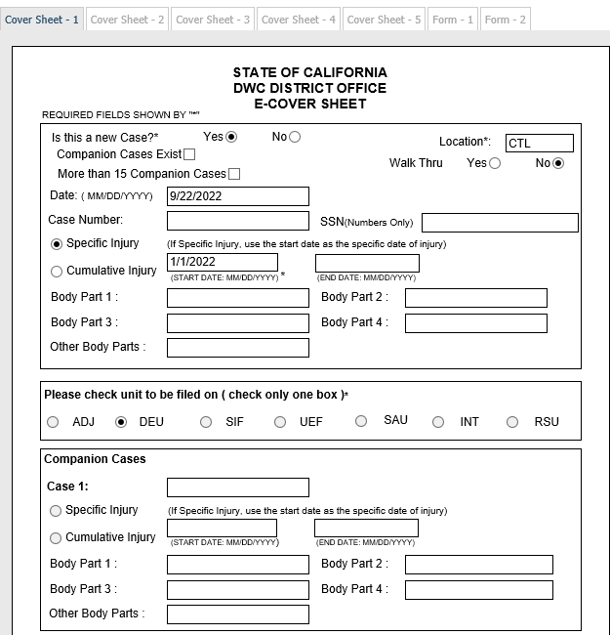
Request for Consultative Rating coversheet
New case: Yes or No. If there is an existing ADJ case already, enter as No.
Location: Choose CTL.
Walk Thru: Yes or No.
Companion cases exist: Select if companions will be listed.
More than 15 Companion cases: DO NOT CHECK.
Date: Enter today’s date MM/DD/YYYY.
Case Number: If there is already an existing ADJ case and no DEU case has been opened, enter the prefix as DEU rather than ADJ. Example: ADJ12345678 should be DEU12345678. If there is already an existing DEU case, enter case DEU case number.
Social Security Number: Optional. (no dashes, just numbers)

Slide 73
Request for Consultative Rating coversheet cont.
Injury type: For a case opening App check correct radio button. If this is not case opening these fields will be blocked.
Specific Injury MM/DD/YYYY.
Cumulative Injury MM/DD/YYYY - MM/DD/YYYY.
Body Part 1-4: These fields are blocked.
Choose Unit type: Select DEU.
Enter Companion Cases. (if any)

Slide 74
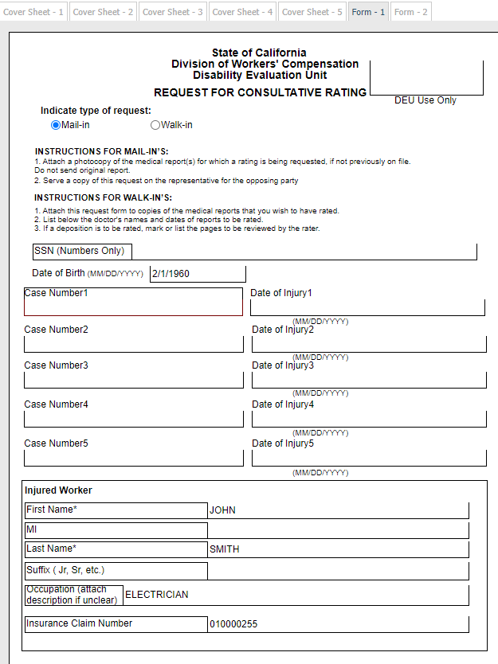
Request for Consultative Rating Form 1
Indicate type of request: Select radio button.
SSN: Optional. (no dashes, numbers only)
Date of Birth: Enter DOB MM/DD/YYYY.
Case numbers: Will auto-populate from the coversheet.
Injured Worker Section:
First Name: First name only.
Middle Initial: One letter only.
Last Name: If adding second last name do not use hyphens.
Suffix: Do not add to this field
Occupation: Enter job title.
Insurance Claim Number:

Slide 75
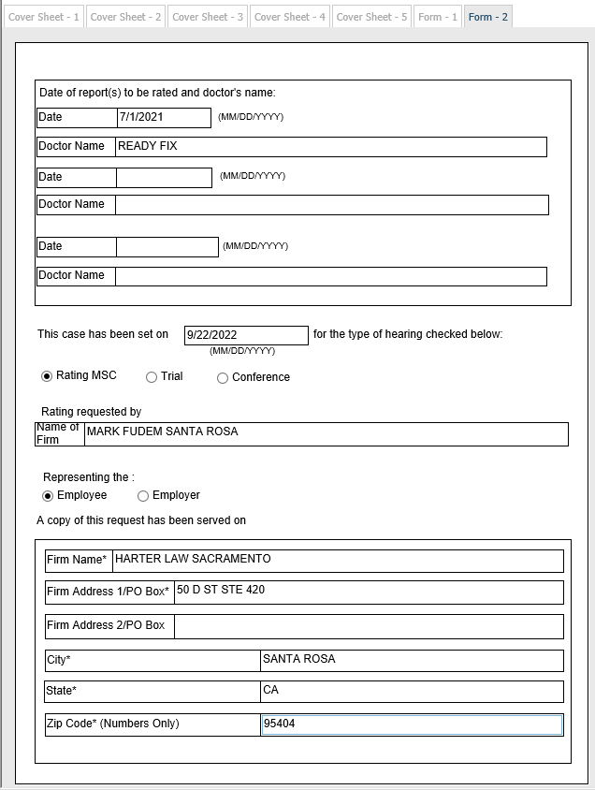
Request for Consultative Rating Form 2
Date of Report to be rated:
Enter Date(s) MM/DD/YYYY.
Doctor's name(s).
Case date: Enter date of hearing.
Type of hearing: Choose one.
Rating MSC
Trial
Conference
Rating requested by: UAN of Law Firm/Non Attorney Representative.
Representing the: Select Employee or Employer.
A copy of this request has been served on:
Firm name: UAN of Law Firm/Non Attorney Representative.
Firm Address 1: Please use USPS format.
Firm Address 2:
City: Verify your city and zip code match.
State: Choose the correct two letter abbreviation from the dropdown menu.
Zip Code: Five digits only.

Slide 76
Compromise and Release Requirements
Reference Guide (see pages 62-65)
eForm: Compromise and Release, all three versions:
Compromise and Release
Compromise and Release Dependency Claim
Third Party Compromise Release
Wet signed document that must mirror the eForm version. Use the document title COMPROMISE AND RELEASE-SIGNED. This is required for all three versions.
Walk-through: §10789 - Medical reports specified and documents relevant to a determination of the adequacy of the settlement not filed previously.
Proof of Service
See Information guidelines for submission of settlement documents: How to e-file settlement documents through EAMS.

Slide 77
Compromise and Release Requirements cont.
Case Opening attachments needed:
  Benefit Notices
  QME waiver
  4906(h)
  Medical reports
  Wage statements
Optional attachments may be included as supportive settlement documents if not already filed.
Possible Dependency C&R attachments needed:
  Petition for Guardian ad Litem
  Death certificate
  Birth certificate(s)
  Marriage license.
Third Party attachments needed:
  Third Party settlement with a wet signed document.
  UAN for Third Party Attorney. Required in order to appear as a case participant in EAMS, and a UAN must be obtained prior to filing.

Slide 78
Compromise and Release Common Errors
Incorrect case number, venue selection, IW information, DOI or UAN for Law Firm or Claims Administrator.
Filing more than one case opening document per coversheet with multiple DOI. (see pages 62-63 in the Reference Guide)
Entering alphabetic text in numeric-only data fields. (Form-6)
eForm is incomplete when compared to the OCR document. The eForm populates the case based on information provided in the eForm, not the wet signed C&R.
(see pages 9-10 in the Reference Guide)
Incorrect document titles used for the attachments.
Missing attachments:
Proof of Service
Wet signed Compromise and Release: Use document title: COMPROMISE AND RELEASE-SIGNED.
Medical reports for non-walk through.
  Proposed Order/Award and supporting documents e-filed separately.

Slide 79
Compromise and Release Helpful Tips
UANs are verified in the UAN database.
IW information verified using the Workers' Compensation Public Search Tool or your intake document. Please note that incorrect IW information is the most common error in the UDQ.
Review attachments for legibility, correctness, meeting the requirements for filing and has an appropriate descriptive document name.
Review contents of the eForm then print it out or save it to your computer before clicking ‘Submit’. If you receive an error message, please remember to print out or save the eForm again to your computer after corrections have been made, because you must serve a complete copy to the other parties listed in your paperwork.

Slide 80
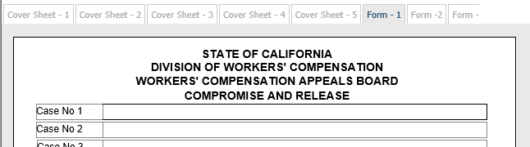


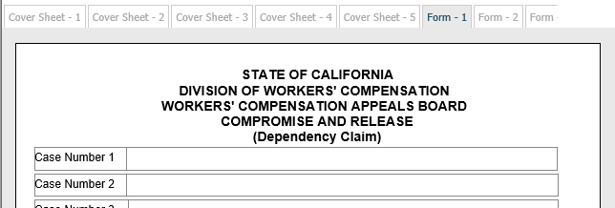
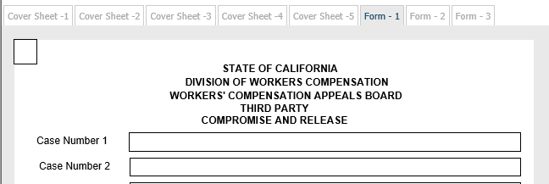
Compromise and Release - Three Versions
Coversheets: All look the same.
Form 1 Page: Shows which version you are using:

Slide 81
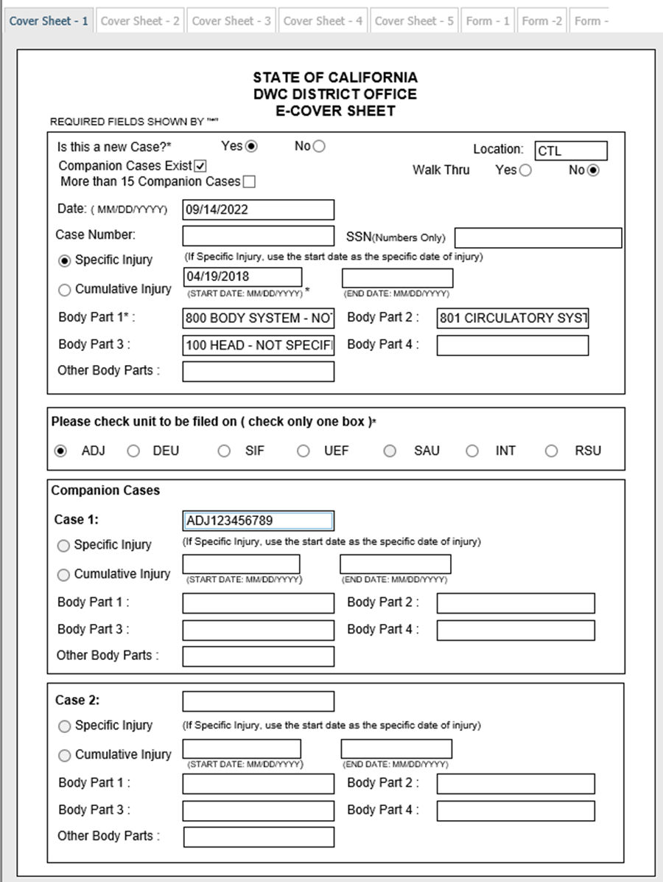
Compromise and Release Coversheet
Example: One new case with an existing companion case
New Case: Select Yes for “Is This a New Case?”
Location: Choose CTL. (indicates the form is e-filed)
Walk Thru: Check the Walk Thru box when you plan to walk-through your C&R. You must verify that your documents are in FileNet before appearing at the district office.
Companion cases exist: Select if companions will be listed.
More than 15 Companion cases: DO NOT CHECK.

Slide 82
Compromise and Release Coversheet cont.
Example: One new case with an existing companion case cont.
Date: Enter today’s date MM/DD/YYYY.
Social Security Number: Optional. (no dashes, numbers only)
Injury type: Check correct radio button, enter either Specific or Cumulative injury and enter date(s) MM/DD/YYYY.
Body Parts: Select from dropdown menus.
Choose Unit type: Select ADJ.
Enter companion case numbers. (if any)
If multiple new case numbers, one or more additional eForms must be completed.

Slide 83
Compromise and Release
Alternate Options for Multiple DOI
Non case opening
  Enter ADJ case number.
  Check Unit type: Select ADJ.
  Enter companion case numbers.
Multiple new cases for DOI that have not been assigned ADJ numbers
  If there are two or more new cases, an additional eForm must be completed for each new case.
  No more than one new case per document coversheet and eForm.
  Existing companion cases entered in the first new document coversheet only.
  Walk-though: No (First new case); Yes (Subsequent new case document coversheets and E-Forms).
  Find new case numbers in EAMS or using the Workers’ Compensation Public Case Search Tool.
  Task & workflow generated for district office staff.

Slide 84
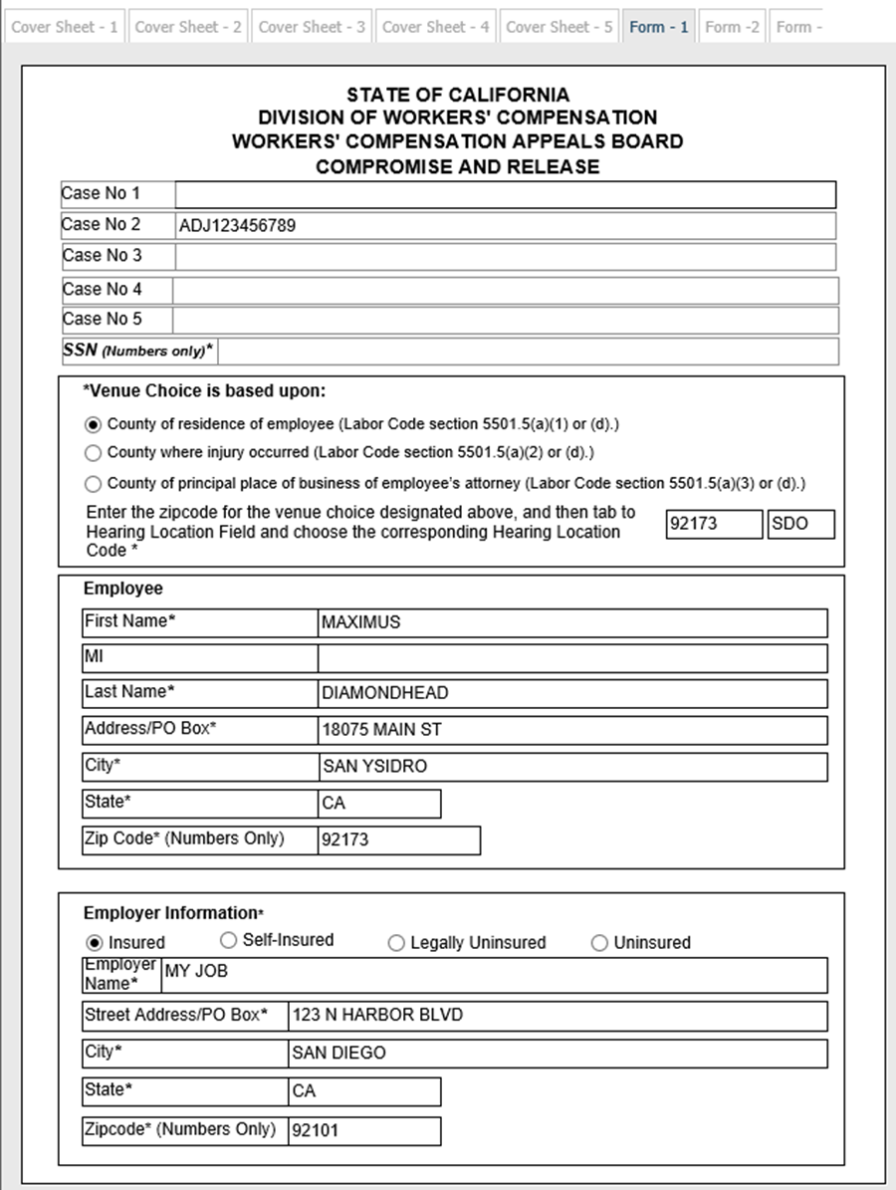
Compromise and Release Form 1
Case Number: Case Number: Auto-populates only from the coversheet for existing cases. A new case number will be created once documents process into EAMS.
SSN: Auto-populates from the coversheet.
Venue choice: Select the appropriate venue button and enter the zip code based on the radio button selection.
County of employee (IW) residence zip code must match employee zip code.
County where injury occurred zip code.
County of principal place of employee's (IW’s) attorney may only be used if the C&R is filed by the employee’s attorney.
Employee Section: (IW cluster)
First name: First name only.
Middle Initial: One letter only.
Last name: If adding second last name do not use hyphens.

Slide 85
Compromise and Release Form 1 cont.
Employee Section cont.:
Street Address/PO Box: Please use USPS format.
City: Verify your city and zip code match.
State: Choose the correct two letter abbreviation from the dropdown menu.
Zip Code: Five digits only.
Employer Information section:
Type of Employer radio buttons: You must select one type of insured/uninsured status for the employer.
Employer Name: Business/Legal Name of the employer.
Employer Address:
Street Address/PO Box: Please use USPS format.
City: Verify your city and zip code match.
State: Choose the correct two letter abbreviation from the dropdown menu.
Zip Code: Five digits only.

Slide 86
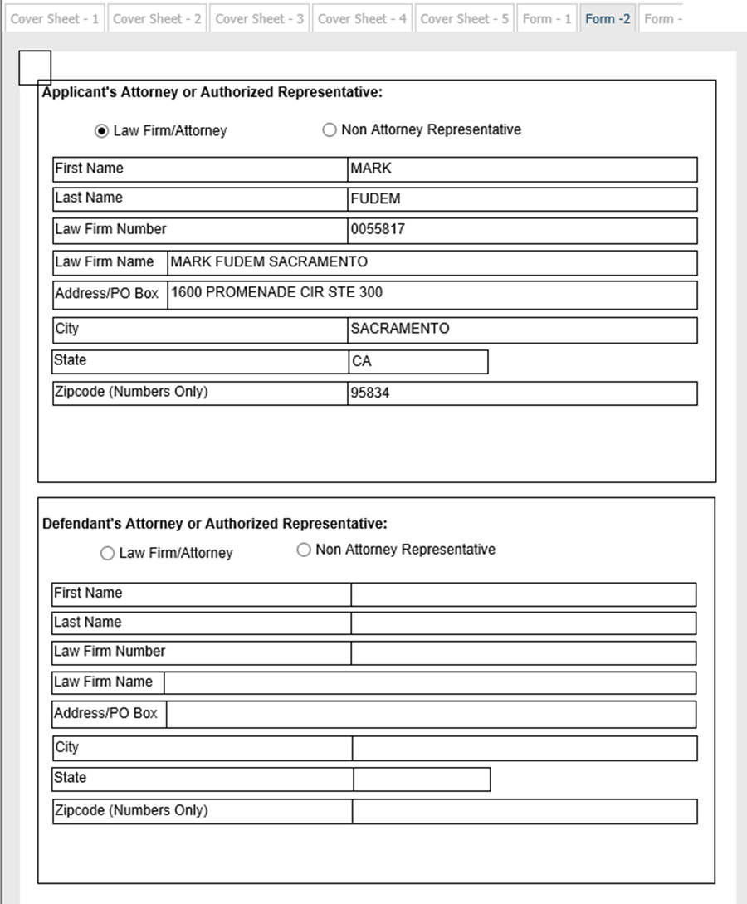
Compromise and Release Form 2
Applicant’s Law Firm/Representative:
Type of Representative radio buttons:
Choose Law Firm/Attorney or Non Attorney Representative
These buttons cannot be unselected if chosen. If clicked, the rest of the fields must be completed.
Representative First Name: First name only.
Representative Last name: If adding second last name do not use hyphens.
Law Firm Number: ERN of Law Firm
Law Firm Name: UAN of Law Firm/Non Attorney Representative.
Representative Address:
Street Address: Please use USPS format.
City: Verify your city and zip code match.
State: Choose the correct two letter abbreviation from the dropdown menu.
Zip Code: Five digits only.

Slide 87
Compromise and Release Form 2 cont.
Defendant Law Firm/Representative:
Type of Representative radio buttons:
Choose Law Firm/Attorney or Non Attorney Representative
These buttons cannot be unselected if chosen. If clicked, the rest of the fields must be completed.
Representative First Name: First name only.
Representative Last name: If adding second last name do not use hyphens.
Law Firm Number: ERN of Law Firm
Law Firm Name: UAN of Law Firm/Non Attorney Representative.
Representative Address:
Street Address: Please use USPS format.
City: Verify your city and zip code match.
State: Choose the correct two letter abbreviation from the dropdown menu.
Zip Code: Five digits only.

Slide 88
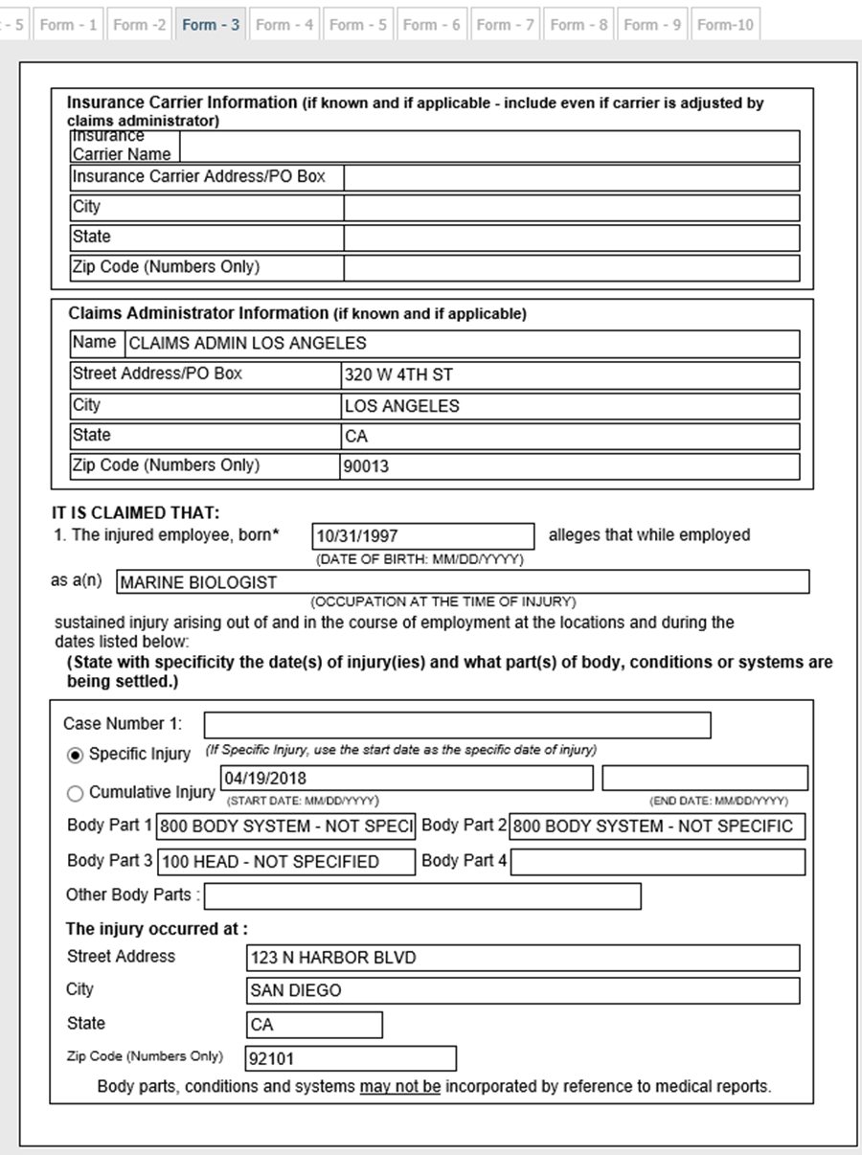
Compromise and Release Form 3
Insurance Carrier field:
Insurance Carrier Name: The Claims Administrator UAN may also be used for this field.
Insurance Carrier Address:
Street Address: Please use USPS format.
City: Verify your city and zip code match.
State: Choose the correct two letter abbreviation from the dropdown menu.
Zip Code: Five digits only.

Slide 89
Compromise and Release Form 3 cont.
Claims Administrator field:
Claims Administrator Name: Enter the Claims Administrator UAN. Some larger insurance companies have more than one Claims Administrator office location so please verify that you have the correct UAN location.
Claims Administrator Address:
Street Address: Please use USPS format.
City: Verify your city and zip code match.
State: Choose the correct two letter abbreviation from the dropdown menu.
Zip Code: Five digits only.

Slide 90
Compromise and Release Form 3 cont.-Paragraph 1
Paragraph 1 It is claimed that:
Injured employee DOB: MM/DD/YYYY
Occupation at time of injury: Enter job title.
Case Number 1: If this is a case opening C&R the case number will be blank. An existing ADJ will auto-populate from the coversheet.
Select Specific/CT Injury radio button: If case opening, the information will auto-populate from the coversheet.
Body Part 1-4: If case opening, the information will auto-populate from the coversheet.
The injury occurred at: Enter the address of the injury site.
Street Address: Please use USPS format.
City: Verify your city and zip code match.
State: Choose the correct two letter abbreviation from the dropdown menu.
Zip Code: Five digits only.

Slide 91
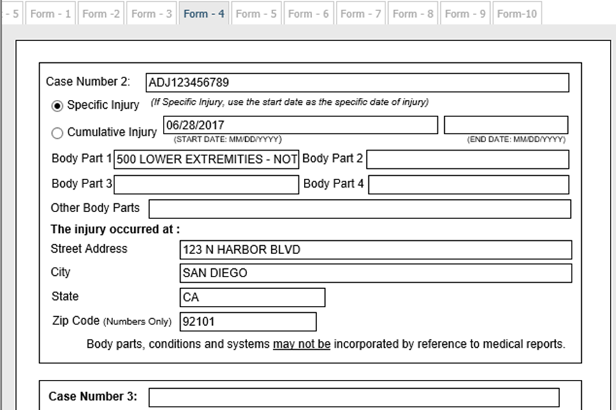
Compromise and Release Form 4 and 5
Companion Cases*:
Enter Companion Case information in Case Number 2-5 fields:
ADJ will auto-populate from the coversheet.
Select Specific/CT Injury radio button: If case opening, the information will auto-populate from the coversheet.
Body Part 1-4: If case opening, the information will auto-populate from the coversheet.
The injury occurred at: Enter the address of the injury site.
Street Address: Please use USPS format.
City: Verify your city and zip code match.
State: Choose the correct two letter abbreviation from the dropdown menu.
Zip Code: Five digits only.
*If there are more than four companion cases on the coversheet only the first four will populate as the form only has room for four companion cases.

Slide 92
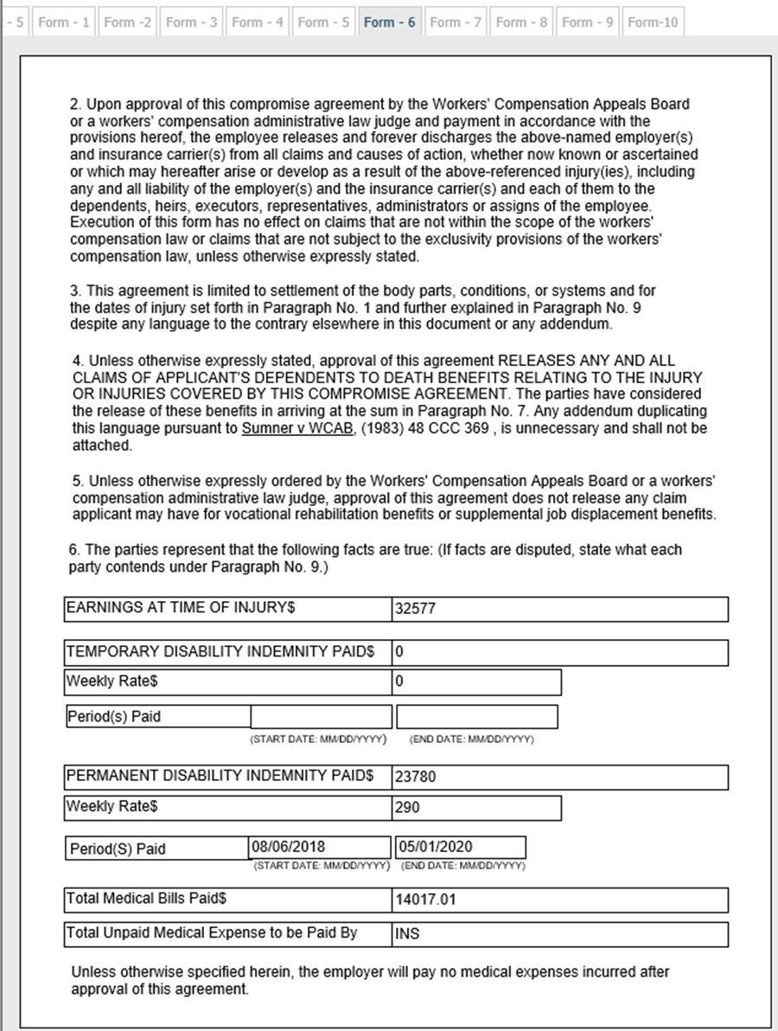
Compromise and Release Form 6
Paragraph 6 The parties represent that:
  All data must be numerical, except the Total Unpaid Medical Expense Paid By field.
  The form will clear if alphabetic characters are entered in any other field.
  Earnings at Time of Injury: Numbers and a decimal point only.
  Temporary Disability (TD) Indemnity Paid:
  Total TD Paid
  TD Rate
  TD Periods Paid
  Permanent Disability (PD) Indemnity Paid:
  Total PD Paid
  PD Rate
  PD Periods Paid
  Total Medical Bills Paid: Numbers and a decimal point only.
  Total Unpaid Medical Expense Paid By: Text allowed.

Slide 93
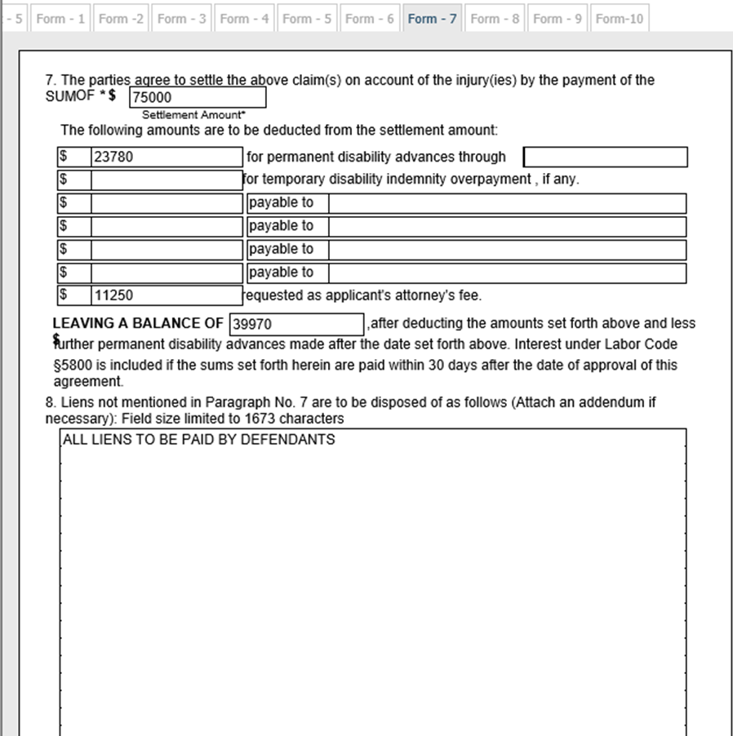
Compromise and Release Form 7
Paragraph 7:
Total Settlement Amount:
Deductions for PD advances.
Deductions for TD overpayment.
Other deductions. (e.g. liens)
Applicant Attorney’s fee.
Settlement balance.
Paragraph 8:
Lien disposition freeform field. (limited to 1673 characters)

Slide 94
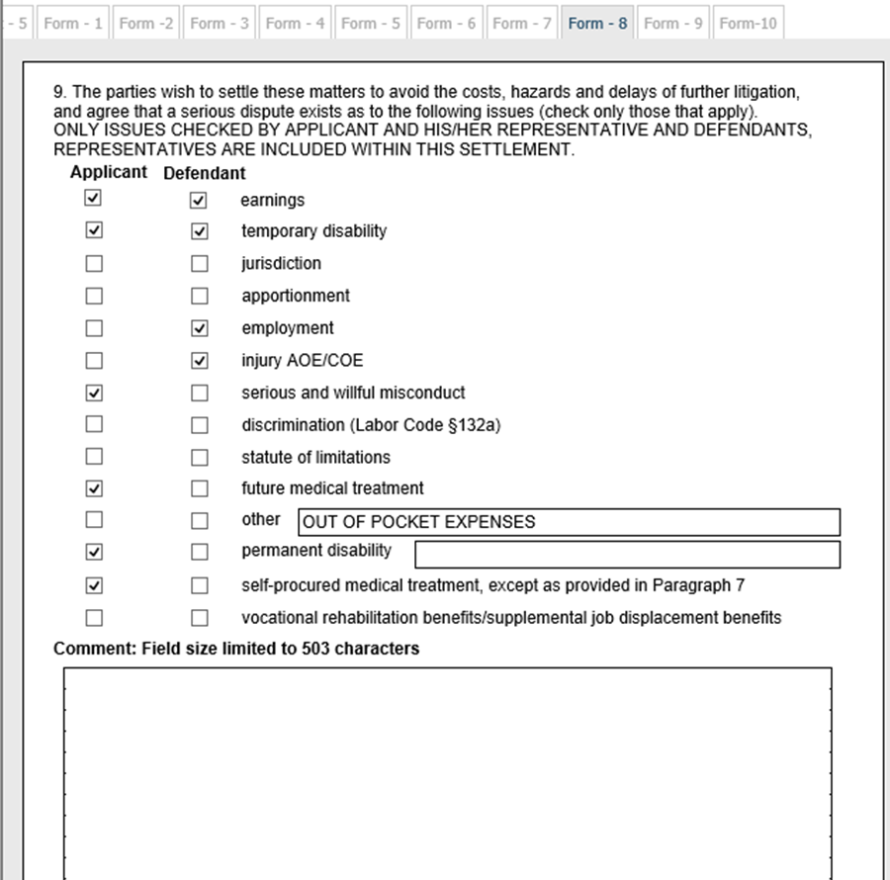
Compromise and Release Form 8
Paragraph 9:
Select all issues that are being settled.
Enter additional comments. (limited to 503 characters)

Slide 95
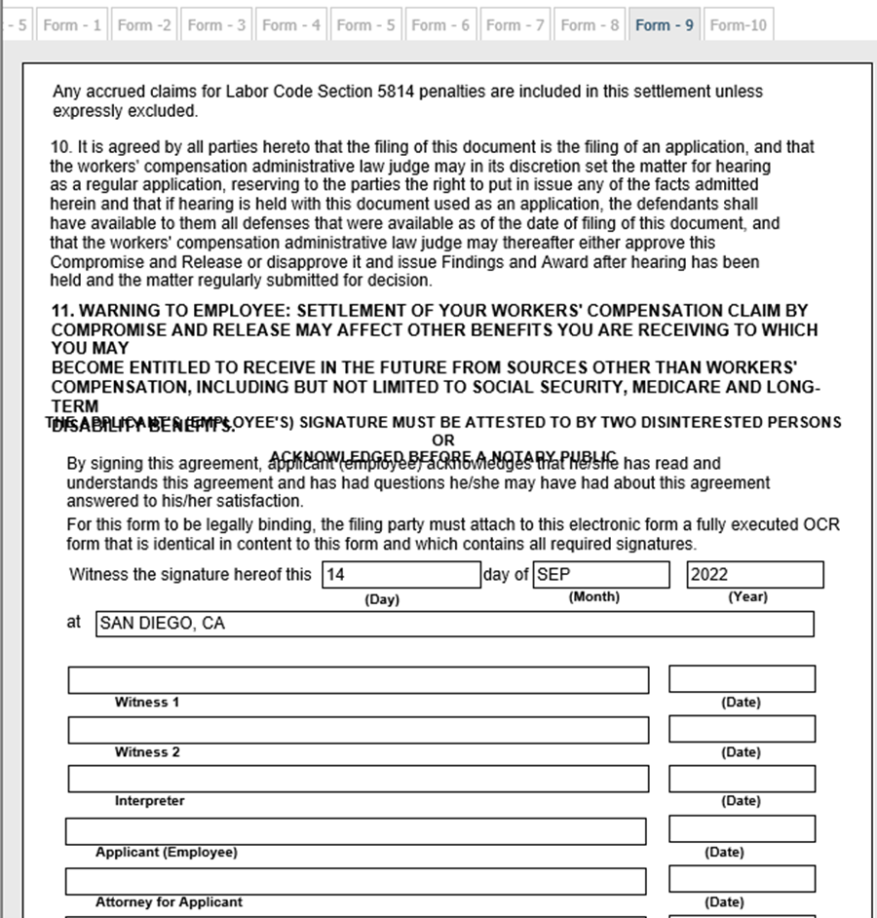
Compromise and Release Form 9
Paragraph 11:
Note text at start of paragraph 11 and acknowledgement prior to the Witness signature date field.
Enter day, month, year, and city.
Signature fields: Leave blank on eForm. The required signatures will be on the OCR wet signed Settlement.

Slide 96
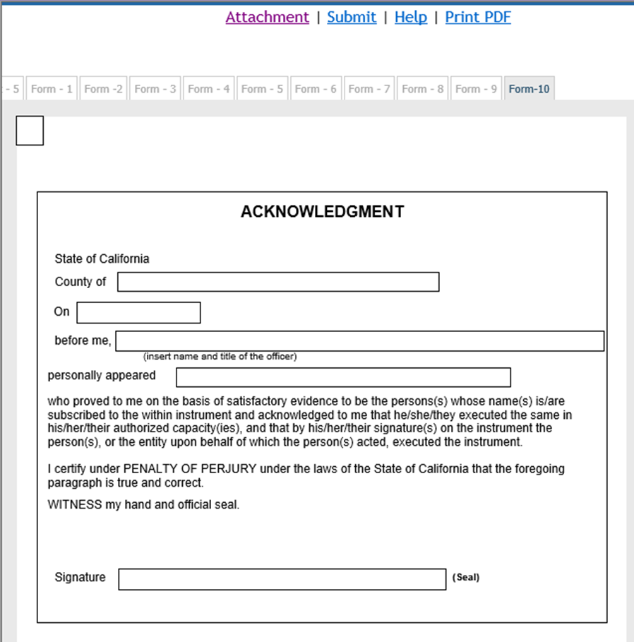
Compromise and Release Form 10
Notary Acknowledgment: Enter only if it is included in wet signed document.
Click on the Attachment link to attach the required documents.

Slide 97
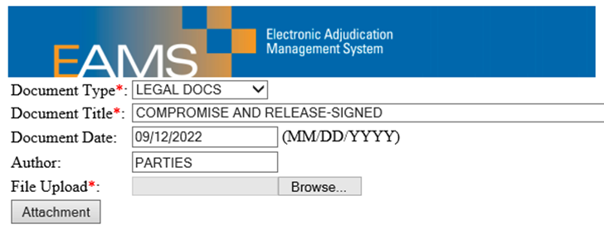


Compromise and Release
Attachments and Submissions
Add all mandatory and optional attachments.
Take a screenshot or print a copy of the attachment page.
Review the data in the eForm for accuracy.
Print the eForm for service on all parties.
Click submit.
Take a screenshot, save as a text file, and/or print the Batch ID page.
Update your Batch ID spreadsheet

Slide 98
Stipulations with Request for Award Requirements
Reference Guide (see pages 62-65)
eForm: Stipulations with Request for Award, three versions:
DOI before 01/01/2013
DOI after 01/01/2013
Death STIP, more than one form may be needed.
Wet signed STIP document must match the eForm version.
Case Opening attachments needed:
  Benefit Notices
  QME waiver
  4906(h)
  Medical reports
  Wage statements
  Proof of Service

Slide 99
Stipulations with Request for Award Requirements cont.
Reference Guide (see pages 62-65)
Optional attachments may be included as supportive settlement documents if not already filed.
Walk-through (§10789):
Medical reports specified and documents relevant to determination of the adequacy of the settlement that have not been filed previously.
Use document title STIPULATIONS WITH REQUEST FOR AWARD-SIGNED.
Do NOT use STIPULATIONS WITH REQUEST FOR AWARD WALK-THROUGH.
See also Guidelines for Submission of Settlement Documents.
Verify that e-filed documents are in FileNet before going to district office.

Slide 100
Stipulations with Request for Award Common Errors
Wrong STIP version for DOI. (wet signed version must match the eForm)
Incorrect UAN for Law Firm or Claims Administrator, Case Number, IW information, or DOI.
Filing more than one case opening document per coversheet with multiple DOI. (see pages 62-63 in the Reference Guide)
eForm incomplete when compared to OCR document. The eForm populates the case based on information provided in the eForm, not the wet signed STIP.
Alphabetic text entered in numeric-only data fields. (Form-6 pre and post 01/01/2013 Stipulations)
Incorrect document titles used for the attachments.
Missing attachments:
  Proof of Service
  Wet signed STIP, remember to use the correct document title, STIPULATIONS WITH REQUEST FOR AWARD-SIGNED.
  Medical reports for non-walk through.
  Proposed Order/Award and supporting documents e-filed separately.

Slide 101
Stipulations with Request for Award Helpful Tips
UANs are verified in the UAN database.
Injured worker information verified using the Workers' Compensation Public Search Tool or your intake document. Please note that incorrect IW information is the most common error in the UDQ.
Remember to include your Proof of Service.
Review attachments for legibility, correctness, meeting the requirements for filing and has an appropriate descriptive document name.
Review contents of the eForm then print it out or save it to your computer before clicking ‘Submit’. If you receive an error message, please remember to print out or save the eForm again to your computer after corrections have been made, because you must serve a complete copy to the other parties listed in your paperwork.

Slide 102
Stipulations with Request for Award
Alternate Options for Multiple DOI
Non case opening
  Enter ADJ case number.
  Check Unit type: Select ADJ.
  Enter companion case numbers.
Multiple new cases for DOI that have not been assigned ADJ numbers
  If there are two or more new cases, an additional eForm must be completed for each new case.
  No more than one new case per document coversheet and eForm.
  Existing companion cases entered in the first new document coversheet only.
  Walk-though: No (First new case); Yes (Subsequent new case document coversheets and E-Forms).
  Find new case numbers in EAMS or using the Workers’ Compensation Public Case Search Tool.
  Task & workflow generated for district office staff.

Slide 103




Stipulations with Request for Award
Three Versions
Coversheets: All look the same.
Form 1 Page: Shows which version you are using:

Slide 104

Stipulations with Request for Award Coversheet
This example is for a Pre 01-01-2013 STIP:
New case: Yes or No.
Location: Choose CTL. (indicates the form is e-filed)
Walk Thru: Check the Walk Thru box when you plan to walk-through your STIP. You must verify that your STIP is in FileNet before appearing at the district office.
Companion cases exist: Please check if other DOI have been assigned an ADJ for this Injured Worker. If the other DOI are unassigned you will need to e-file multiple STIPs.
More than 15 Companion cases: DO NOT CHECK.
Date: Enter today’s date MM/DD/YYYY.
Social Security Number: Optional. (no dashes, numbers only)

Slide 105
Stipulations with Request for Award Coversheet cont.
Coversheet cont.:
Case Number:
If case opening leave blank.
If the DOI has been assigned an ADJ, enter the ADJ case number.
Injury type: Check correct radio button for Specific or Cumulative Injury and enter date(s) if case opening STIP MM/DD/YYYY.
Body Part: Select from the dropdown menu if case opening STIP.
Choose Unit type: Select ADJ.
Companion Cases: Enter the companion ADJs that are listed on the settlement. You cannot fill in the DOI and Body Parts here on the Coversheet, only on Form 5.

Slide 106

Stipulations with Request for Award Form 1
Case Number: Field will be blank for a case opening STIP, but will auto-populate for existing ADJs.
DOI: Will auto-populate from the coversheet for a case opening STIP, but you will need to enter it for an established ADJ MM/DD/YYYY.
SSN: Auto-populates from the coversheet.
Venue Choice: Select the appropriate Venue button and enter the zip code based on the radio button selection.
County of employee (IW) residence zip code must match the employee’s zip code.
County where injury occurred zip code.
County of principal place of employee's (IW’s) attorney may only be used if the STIP is filed by the employee’s attorney.

Slide 107
Stipulations with Request for Award Form 1 cont.
Applicant:
First Name: First name only.
Middle Initial: One letter only.
Last Name: If adding second last name do not use hyphens or other special characters.
Applicant Address:
Street Address/PO Box: Please use USPS format.
City: Verify your city and zip code match.
State: Choose the correct two letter abbreviation from the dropdown menu.
Zip Code: Five digits only.

Slide 108
Stipulations with Request for Award Form 1 cont. 2
Employer Information section:
Type of Employer radio buttons: You must select one type of insured/uninsured status for the employer.
Employer Name: Business/Legal Name of the employer.
Employer Address:
Street Address/PO Box: Please use USPS format.
City: Verify your city and zip code match.
State: Choose the correct two letter abbreviation from the dropdown menu.
Zip Code: Five digits only.
Insurance Carrier field:
Insurance Carrier Name: The Claims Administrator UAN may also be used for this field.

Slide 109

Stipulations with Request for Award Form 2
Insurance Carrier field Cont.
Insurance Carrier Address:
Street Address/PO Box: Please use USPS format.
City: Verify your city and zip code match.
State: Choose the correct two letter abbreviation from the dropdown menu.
Zip Code: Five digits only.
Claims Administrator field:
Claims Administrator Name: Enter the Claims Administrator UAN. Some larger insurance companies have more than one Claims Administrator office location so please verify that you have the correct UAN location.
Claims Administrator Address:
Street Address: Please use USPS format.
City: Verify your city and zip code match.
State: Choose the correct two letter abbreviation from the dropdown menu.
Zip Code: Five digits only.

Slide 110

Stipulations with Request for Award Form 3 & 4
Employer Information section cont.
Form 3 and Form 4 are used for any additional Employers; up to four with their Insurance Carriers and Claims Administrators.
If there are more than four Employers, you may add them as an addendum to the STIP using document title CORRESPONDENCE – OTHER.

Slide 111

Stipulations with Request for Award Form 5
Section 1:
Employee Section:
First Name: First name only.
Last Name: If adding a second last name do not use hyphens or other special characters​.
DOB: Enter DOB and verify that it is not the DOI as this can create a duplicate IW profile, duplicate case, or err to the UDQ.
While employed at: Enter City and State where the employee was injured.
While employed as: Enter the employee’s job title at the time of injury.
More than 4 Companion Cases button: Do not choose this button. If there are more than 4 companion cases, list these on the coversheet.
Case Number 1: If this is a case opening STIP the case number will be blank. Existing ADJs will auto-populate from the coversheet.

Slide 112
Stipulations with Request for Award Form 5 cont.
Case Number 1 cont.:
Select Specific/CT injury radio button: If case opening the information will auto-populate from the coversheet.
Body Part 1-4: If case opening the information will auto-populate from the coversheet.
Companion Cases: Companion Case 2 to 3 information.
The ADJ will auto-populate from Coversheet-1.
Select Specific/CT Injury radio button.
Enter DOI MM/DD/YY.
Select Body Parts from the dropdown menu.

Slide 113

Stipulations with Request for Award Form 6
Companion Cases: Companion Case 4 information.
The ADJ will auto-populate from Coversheet-1.
Select Specific/CT injury radio button.
Enter DOI MM/DD/YYYY.
Select Body Parts from the dropdown menu.
If there are more than four companion cases on the coversheet only the first three will be listed here.
By the employer(s) and their insurer(s): Note that the “Stipulations go here.”
Section 2
The injury(ies) caused temporary disability:
Start date: MM/DD/YYYY
End Date: MM/DD/YYYY
Has been paid: Numbers and a decimal point only.

Slide 114
Stipulations with Request for Award Form 6 cont.
Section 2 cont.
2(a). The injury(ies) caused additional temporary disability:
Start date: MM/DD/YYYY
End Date: MM/DD/YYYY
At the rate of: Numbers and a decimal point only.
In the amount of: Numbers and a decimal point only.
Section 3
The injury(ies) caused permanent disability:
of (% of disability): Enter a zero if no permanent disability.
at: Amount of indemnity paid per week.
beginning: MM/DD/YYYY
in the sum of: Amount of indemnity paid.
less credit for payments...:
If life pension click the box and enter the amount: Numbers and a decimal point only.

Slide 115
Stipulations with Request for Award Form 6 cont.- Sec 3
Section 3 cont.:
Labor Code §4658(d) adjustment: Choose one.
Increase rate to: Numbers and a decimal point only.
as of: MM/DD/YYYY
Decrease rate to: Numbers and a decimal point only.
as of: MM/DD/YYYY
Not applicable.
An informal rating: Choose one.
Has or has not been previously issued.
In case no(s): Enter an ADJ case number that has a rating.

Slide 116

Stipulations with Request for Award Form 7
Section 4:
There is/is not a need for medical: Check one.
Section 5:
Medical Legal Expenses: List expenses and liens.
Section 6:
Applicant’s attorney requests fee of: Numbers and a decimal point only.
Fees to be commuted: Check box if needed and enter information regarding these fees in the box. (field limited to 256 characters)
Section 7:
Liens against compensation are payable as follows: List any further lien information. (field limited to 440 characters)

Slide 117

Stipulations with Request for Award Form 8
Section 8:
Any accrued claims for Labor Code 5814 penalties.
Section 9:
Other stipulations field limited to 1024 characters: List stipulations. If there is not enough room in this field, please summarize and add a more detailed addendum to your STIP using the document title CORRESPONDENCE – OTHER.
Dated: MM/DD/YYYY
Applicant Signature: S Signature.

Slide 118

Stipulations with Request for Award Form 9
Applicant Law Firm/Representative:
Type of Representative radio buttons: These buttons cannot be unselected if chosen. If clicked the rest of the fields must be completed.
Rep First Name: First name only.
Rep Last Name: If adding second last name do not use hyphens.
Law Firm Number: ERN of Law Firm.
Law Firm Name: UAN of Law Firm/Non Attorney Representative.
Representative Address:
Street Address/PO Box: Please use USPS format.
City: Verify your city and zip code match.
State: Choose the correct two letter abbreviation from the dropdown menu.
Zip Code: Five digits only.
Dated: MM/DD/YYYY
Applicant Attorney Signature: S Signature

Slide 119
Stipulations with Request for Award Form 9 cont.
Defendants Law Firm/Representative:
Type of Representative radio buttons:
Choose Law Firm/Attorney or Non Attorney Representative. ​
These buttons cannot be unselected if chosen. If clicked, the rest of the fields must be completed.
Rep First Name: First name only.
Rep Last Name: If adding second last name do not use hyphens.​
Law Firm Number: ERN of Law Firm.
Law Firm Name: UAN of Law Firm/Non Attorney Representative.
Representative Address:
Street Address/PO Box: Please use USPS format.
City: Verify your city and zip code match.
State: Choose the correct two letter abbreviation from the dropdown menu.
Zip Code: Five digits only.
Dated: MM/DD/YYYY
Applicant Attorney Signature: S Signature

Slide 120

Stipulations with Request for Award Form 10
Additional Defendant's Attorney fields:
Two more Law Firm/Attorney or Non Attorney Representatives can be added here.

Slide 121

Stipulations with Request for Award Form 11
Notary Acknowledgment: Enter only if it is included in wet signed document.
Click on the Attachment link to attach the required documents.

Slide 122

Stipulations with Request for Award
Attachments & Submissions
Add all mandatory and optional attachments.
Take a screenshot or print a copy of the attachment page.
Review the data in the eForm for accuracy.
Print the eForm for service on all parties.
Click submit.
Take a screenshot, save as a text file, and/or print the Batch ID page.
Update your Batch ID spreadsheet.

Slide 123
Unstructured eForm Common Errors
Reference Guide (see pages 14 & 66)
Incorrect Case Number – documents may go into the wrong case if that case number exists.
Case numbers in the Attachment screen do not match.
Companion cases must be for the same injured worker in the same batch.
Attachments labeled incorrectly.
Attachments are copies of structured eForms or OCR forms.

Slide 124
Unstructured eForm Helpful Tips
All Case Numbers entered must match the existing Case Numbers in EAMS.
Prepare and review attachments for correctness and meeting the file naming convention.
Author field: If created by a UAN holder the UAN should be used. If created by the physician, the Doctor's name should be used.
If an attachment is related to a lien, enter the Lien Reservation Number.
Review contents of the Attachment screen and then print it out or save it to your computer before clicking ‘Submit’.
Print and/or save a text copy of the Batch ID page.

Slide 125
When and how to contact DWC for assistance
Error messages while attempting to submit e-forms. (DOR errors, missing, or incorrect required information)
Contact EAMSHelpDesk@dir.ca.gov to get assistance.
Need copies of filed documents.
View FileNet documents to download or print. (see pages 72-73 in the Reference Guide)
I cannot find my documents in EAMS. (UDQ or employment association issues)
Contact EFORMS@dir.ca.gov to get assistance.
I made a mistake in the documents that have been filed.
Contact EAMSHelpDesk@dir.ca.gov and the district office to get assistance.

Slide 126
DWC-EAMS Mailbox Options
Please note that inquiries sent to the incorrect mailbox may result in lengthy delays in response time. Only Primary Administrators should send a request for information or assistance.
EAMS (EAMS@dir.ca.gov) – general questions for non e-filers.
CRU (CRU@dir.ca.gov) – only for UAN registration and updates, Change of Handling Location, and Change of claims administrators.
EAMSHelpDesk (EAMSHelpDesk@dir.ca.gov) – hearing slot errors, for information & assistance as specified in the Guide, verify if batch erred to UDQ or verify settlement documents in FileNet.
EFORMS (EFORMS@dir.ca.gov) – unarchive cases, e-filer account issues, errors or messages to UDQ Supervisor (note that messages to the UDQ should have UDQ Supervisor in the subject line), IW address issues, incorrect IW issues, updates to IW or Employer names, FileNet document received dates (Notice of Document Discrepancy); See Page 18 in the Reference Guide.

Slide 127
Time for a Quiz
Congratulations you finished the EAMS UDQ training presentation.
In order to complete the training, you must take a quiz to demonstrate your understanding of how to successfully e-file in EAMS.
Send a request for a quiz to EFORMS@dir.ca.gov and be sure to include your ERN, UAN, and “UDQ Quiz” in the Subject line.
You must receive a score of 15 or higher out of 20 (75%) to be considered as passing. If you do not meet this minimum score, you will be asked to wait a week, during which time you should review the presentation and the Reference Guide again, before sending in a request for another quiz.
If you are unable to receive a passing score within two attempts, your e-filer account may be subject to temporary suspension.

